Slide 2
bor

Slide 3
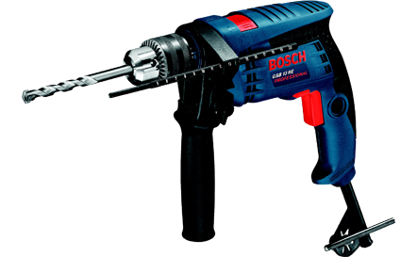
bor
It seems that there is some confusion as to the meaning of “bor” in Indonesian. Does it mean “boredom” or is it a “feral pig” or “wild boar”? Unfortunately, it is neither!
The noun “bor” means “drill” and the verb “membor” means “to drill” in Indonesian.

Slide 4
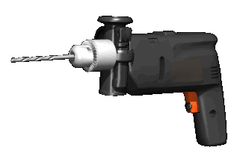
bor
I’ve found the WORD of the DAY a great way to “drill” you in Indonesian vocabulary!
I can only hope it doesn’t “bor” you!

