Slide 2
bisik

Slide 3
bisik
Just in case you’re thinking that “bisik” means to “be sick” or “vomit”, let me assure you that it doesn’t!
The verb “bisik” or “berbisik”, pronounced “bih-sick”, means “to whisper” in Indonesian.

Slide 4
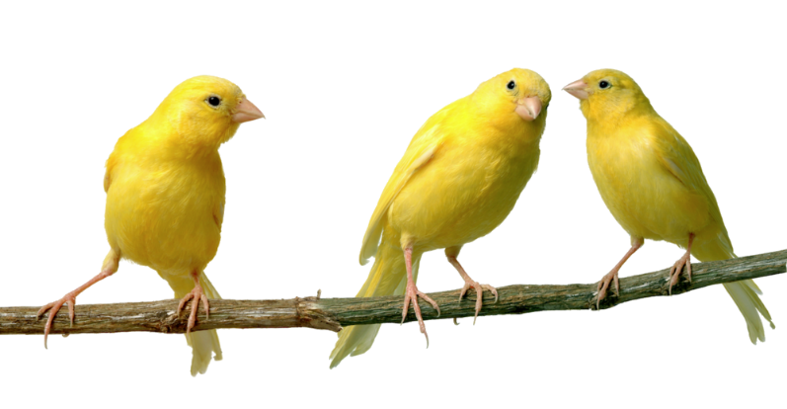
bisik
As whispering is considered rude and arouses suspicion, I can provide you with the perfect solution to this dilemma.
Just learn to speak Indonesian fluently and you can gossip about other people all the time without them realising! It works for me!
Pakai Bahasa Indonesia aja supaya enggak ada yang ngerti !
Iya, deh!

