Slide 2
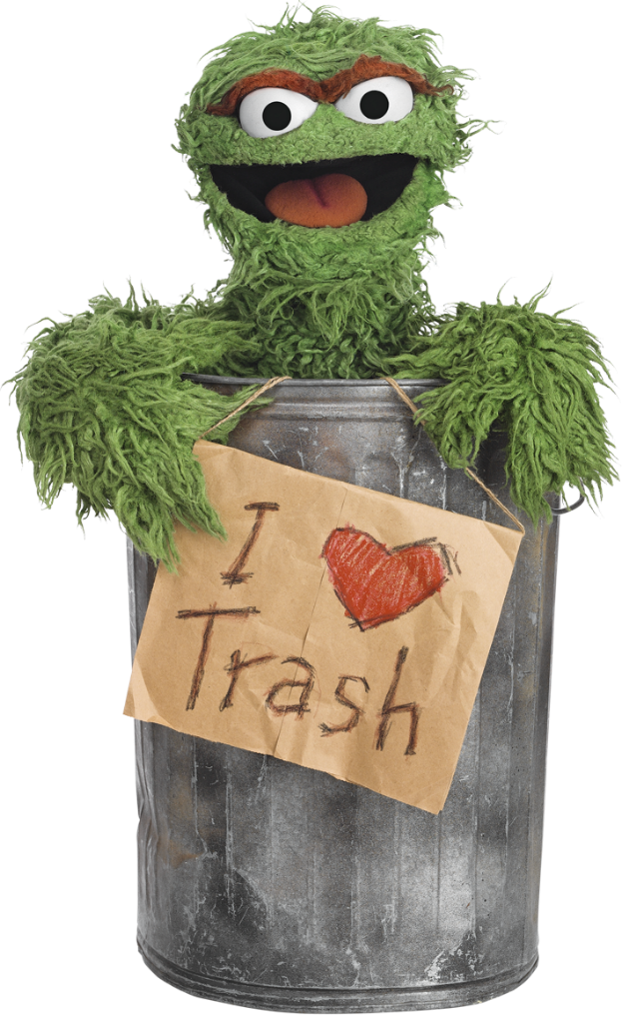
bintang

Slide 3
bintang
I’ll bet you’re thinking that “bintang”, pronounced “bin-tongue”, is some new kind of bin that gobbles up your rubbish, right?
Well, sorry to disappoint you, but that’s a load of rubbish!
The noun “bintang” means “star” in Indonesian.

Slide 4
bintang
I can see that you are already “star” struck! But that’s okay because Indonesians also use “bintang” to describe film stars, music stars and sporting stars! Can you guess what a “bintang film” is?

Slide 5
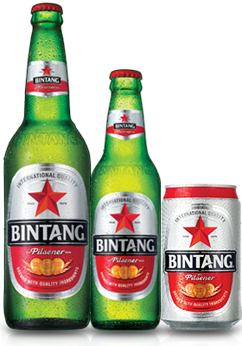
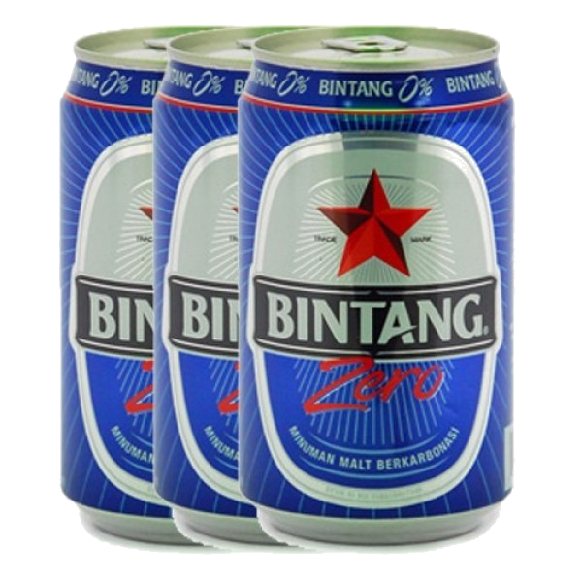
bintang
Despite the many “bintang” in the world, there is only one “BINTANG” that Aussies are interested in when they go to Bali. You guessed it!

