Slide 2
binatang

Slide 3
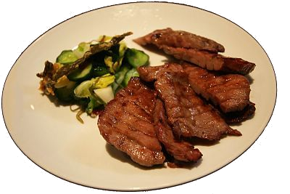
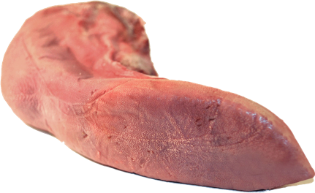
binatang
You are probably thinking that “binatang”, pronounced “bin-a-tongue” means to dispose of a tongue in the bin, right? Not in Indonesia it doesn’t, where animal tongues are eaten as a delicacy! There’s no need to be disgusted … many westerners also eat ox tongues!

Slide 4
binatang
The noun “binatang”, along with “hewan” means “animal” in Indonesian. Can you guess what “dokter hewan” means?

Slide 5
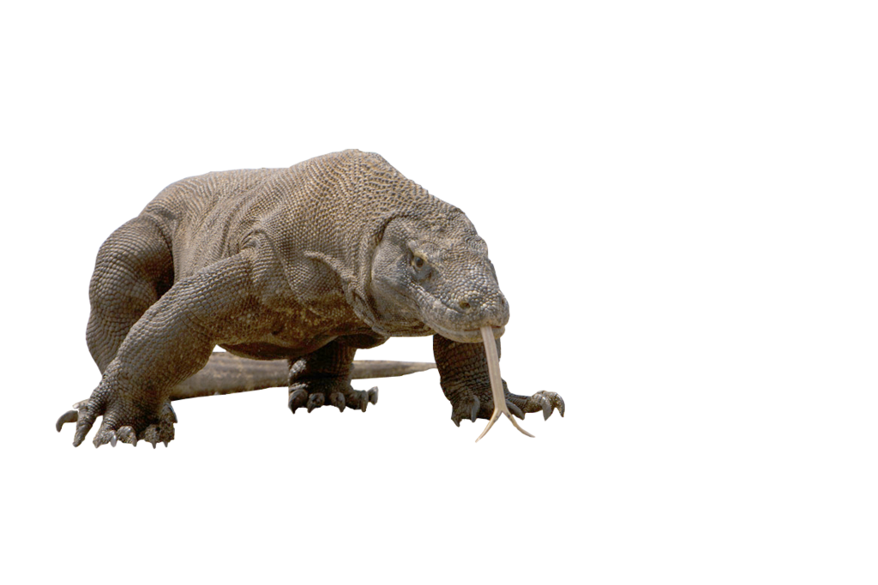
binatang
Some of Indonesia’s fauna (“binatang”) are so unique, they are found nowhere else on earth.

Slide 6
binatang
A word of advice … don’t ever try to “bin-a-tongue” of a Komodo Dragon.

