Slide 1
Berbelanja
Kelas 7/8
By the end of this unit, I will be able to:
Name a range of items to buy
Describe things I want to buy
Ask for and give the price of different items
Bargain in Indonesian
Ask and give directions
Write dialogue in Indonesian
Perform dialogue in Indonesian
Read and respond to text on the topic
Listen and respond to text on the topic
Activities to support learning from: Fenton, Joanne/Gould-Drakely, Melissa/Harjoso, Ida/Yang, Ilian; Saling Silang 2 Textbook; Pearson Australia 2013; Chapter 3

Slide 2
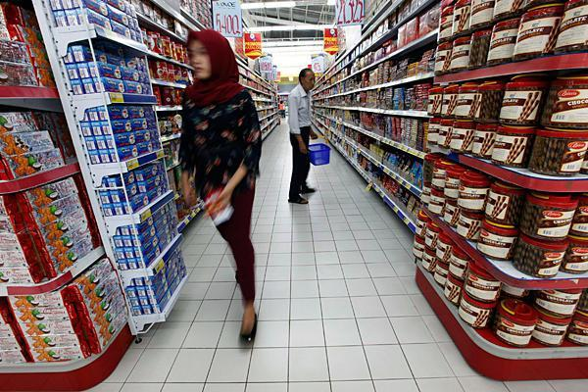
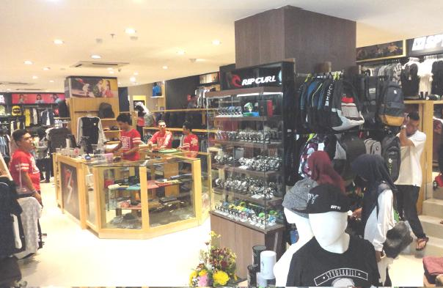
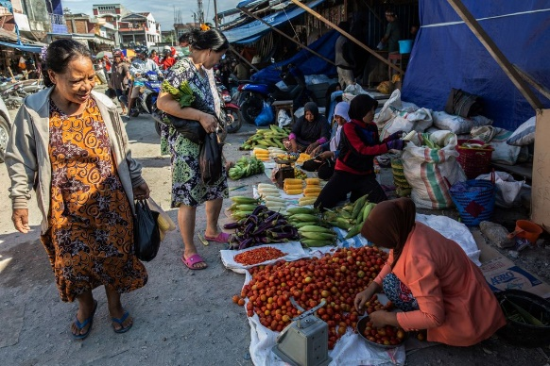
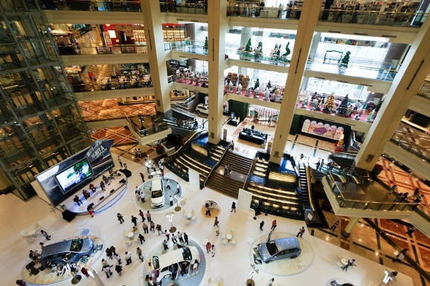
Kamu mau berbelanja di mana? Where do you want to shop?
supermarket
toko
shop
pasar
market
mal/plaza
Saya mau berbelanja di …………. karena saya perlu membeli ……….
I want to shop at ……….. because I need to buy ………..

Slide 3
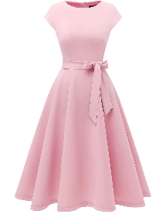
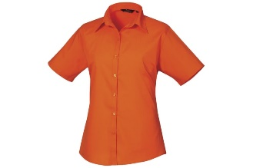
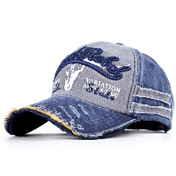
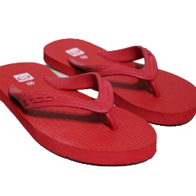
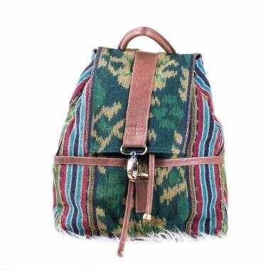
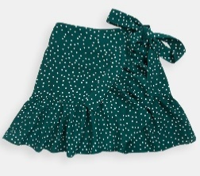
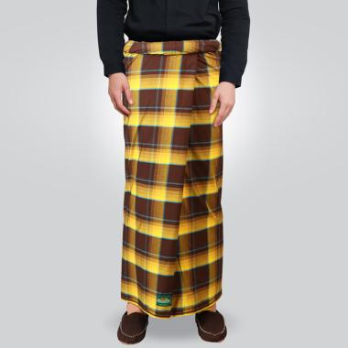
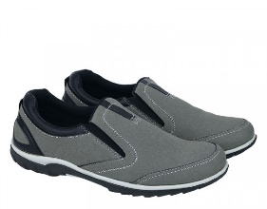
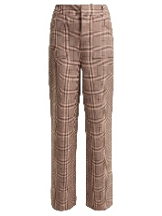
Kamu mau beli apa? Pakaian. What do you want to buy? Clothing.
dres
baju
topi
rok
sandal jepit
tas
sarung
sepatu
celana

Slide 4
Batik. Apa itu? Batik. What’s that?
Research ‘batik’ in Indonesia. On the next slide, create an informative text (demonstrate use of information text features) to show your understanding of what batik is, how it is created and how/why it is important in Indonesian culture.
Challenge: Do we have an equivalent of batik in Australia?

Slide 5
Laporan: Batik. Apa itu? Report: Batik. What’s that?

Slide 6
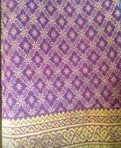
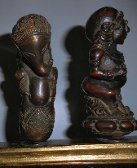
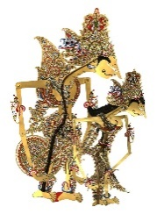
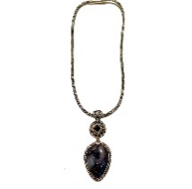
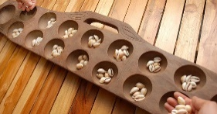
Kamu mau beli apa? Oleh-Oleh. What do you want to buy? Souvenirs.
kain batik
sarung
tenunan
cincin
ukiran kayu
wayang
kalung
congklak

Slide 7
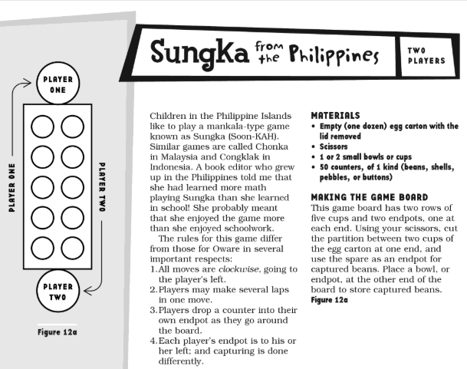
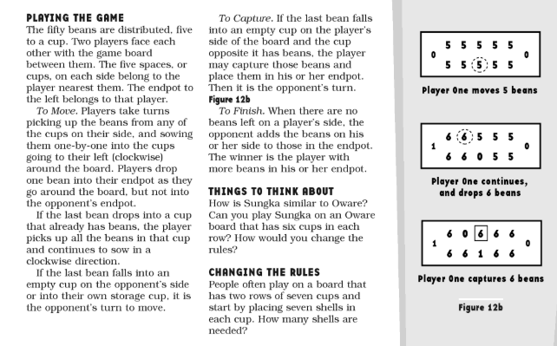
Mari kita bermain congklak! Let’s play congklak!
The Indonesian game of ‘conglak’ is much the same as ‘sungka’ from the Philippines.
Have a go at making your own and play with your family!
Source: Zaslavsky, Claudia; Math Games and Activities from Around the World; Chicago Review Press, 1998; page 26-27

Slide 8
Durian. Apa itu? Durian. What’s that?
Research ‘durian’.
Record your notes and pictures on this slide.

Slide 9
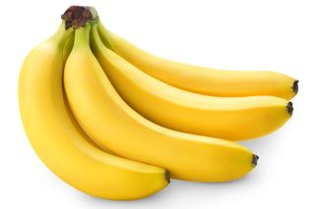
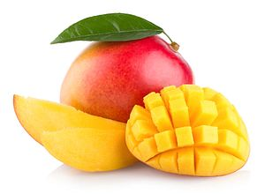
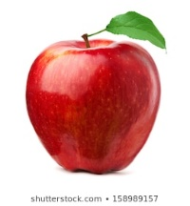
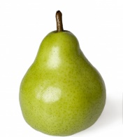
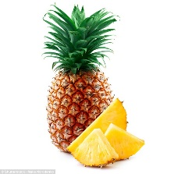
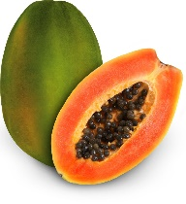
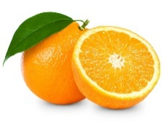
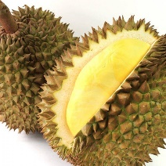
Kamu mau beli apa? Buah-Buahan. What do you want to buy? Fruit.
pisang
mangga
Ingatlah!
‘se’ as a prefix can mean ‘one of’
sekilo – one kilo (eg. sekilo jeruk)
seikat – one bunch (eg. seikat anggur)
sesisir – one hand (pisang only)
sebuah – one item (sebuah mangga)
apel
pir
nanas
pepaya
jeruk
durian

Slide 10
Uang Dunia World Currency
Research – what is the currency of Indonesia?
How does it convert to the Australian Dollar, American Dollar, Euro, Peso etc?
Create a table to show your findings.

Slide 11
Berapa harganya? How much is it?
Ingatlah!
‘berapa?’ is the word we use to ask questions that involve a numerical answer.
Jam berapa? - What time?
Kelas berapa? – What grade?
Berapa umurmu? – How old are you?
Ada berapa? – How many are there?
As a price is a number, we also use ‘berapa’ to ask the cost of things. This can be done in two ways:
Berapa harganya? – What is the price?
Berapa ongkosnya? – What is the cost?
Contoh:
Pembeli: Berapa harganya?
Buyer: What is the price?
Penjual: Harganya ……. rupiah.
Seller: The price is …….. rupiah.
Pembeli: Berapa ongkosnya?
Buyer: What is the cost?
Penjual: Ongkosnya ……. rupiah.
Seller: The cost is …….. rupiah.

Slide 12
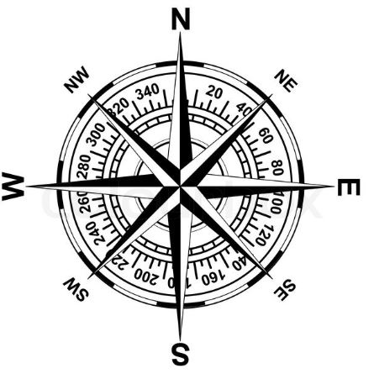
Bagaimana ke sana? How do I get there?
Utara
Ingatlah!
Prepositions di, ke, dari and sampai can be used when asking for or giving directions.
di – in/on/at
ke – to
dari – from
sampai – until
‘Jalan’ is the word used for any street/road.
Contoh: Jalan Kelly = Kelly street
belok ke kanan
belok ke kiri
Barat
Timur
terus sampai….
Selatan
perempatan

