Slide 2
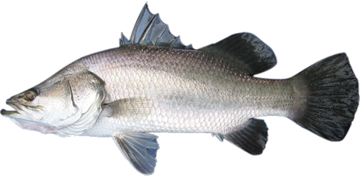
baru mandi

Slide 3
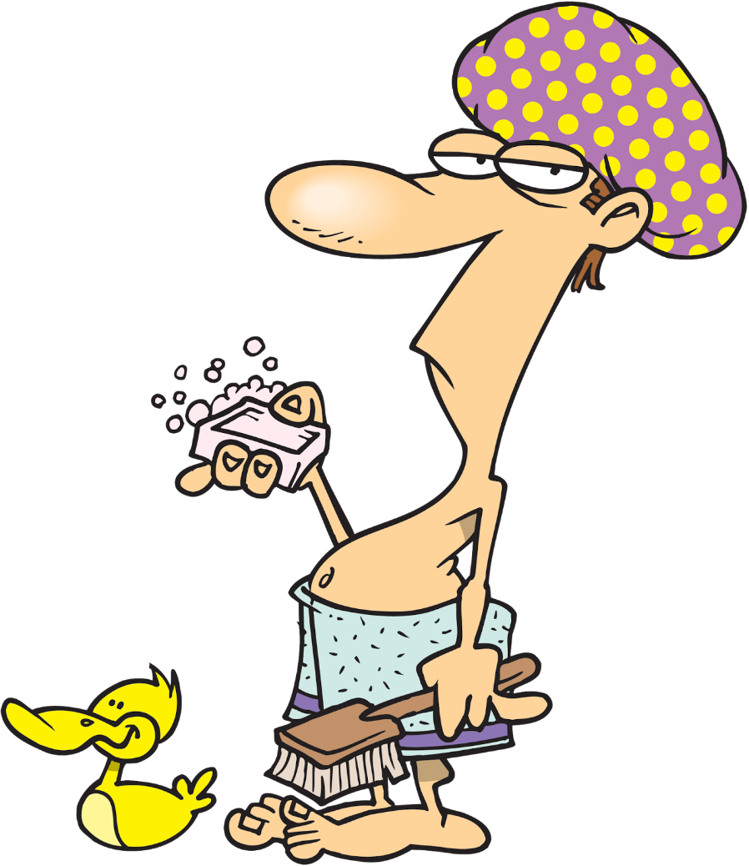
baru mandi
You are probably thinking that “baru mandi” is the Indonesian for “barramundi”, right? That sounds just a little bit ‘fishy’ to me!
Indonesians are always keen to tell someone that they’ve “just bathed”: “Saya baru mandi!” (bar-roo mun-dee).

Slide 4
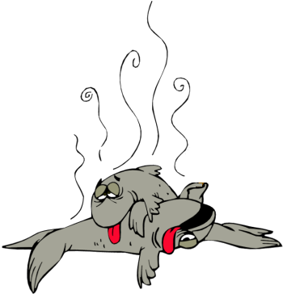
baru mandi
If you’re the type who only has a “mandi” once a week, you probably smell like a week-old discarded “barramundi”!

Slide 5
baru mandi

