Slide 2
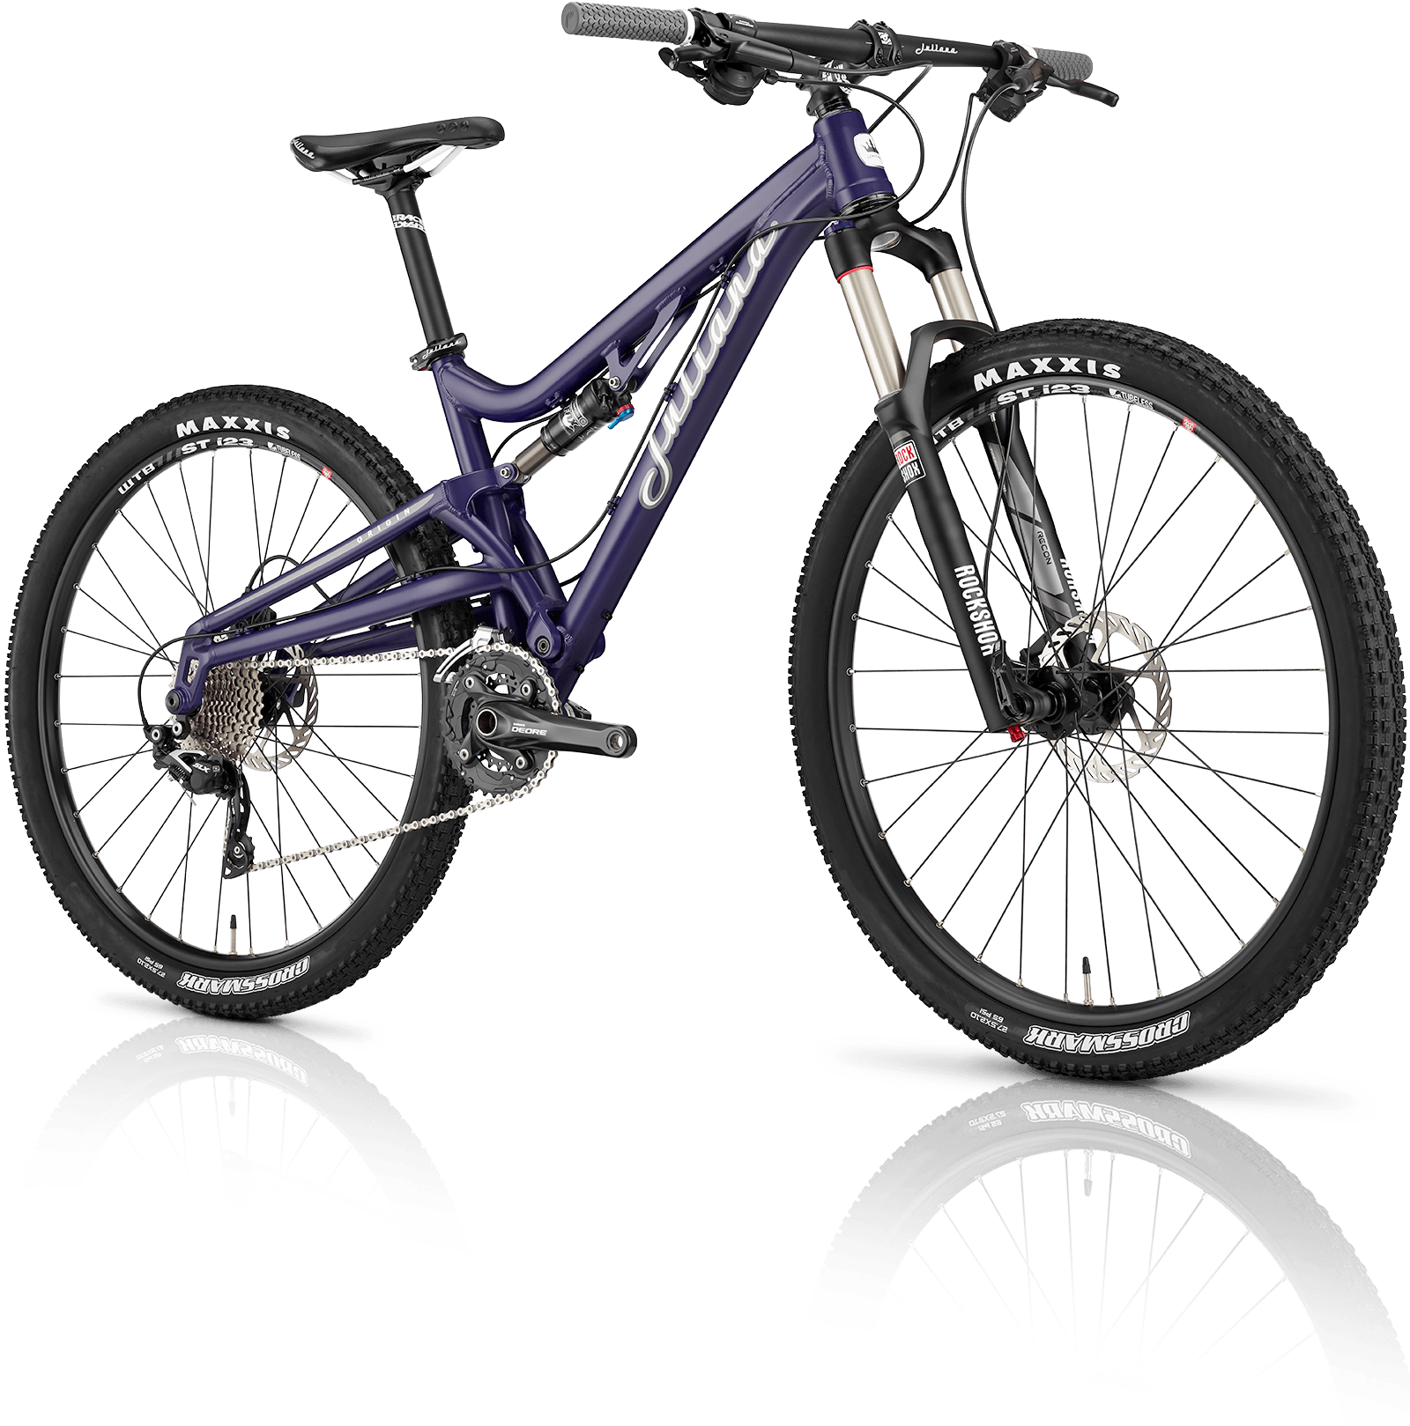
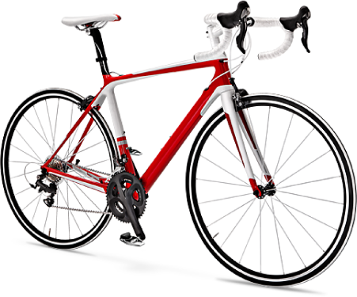
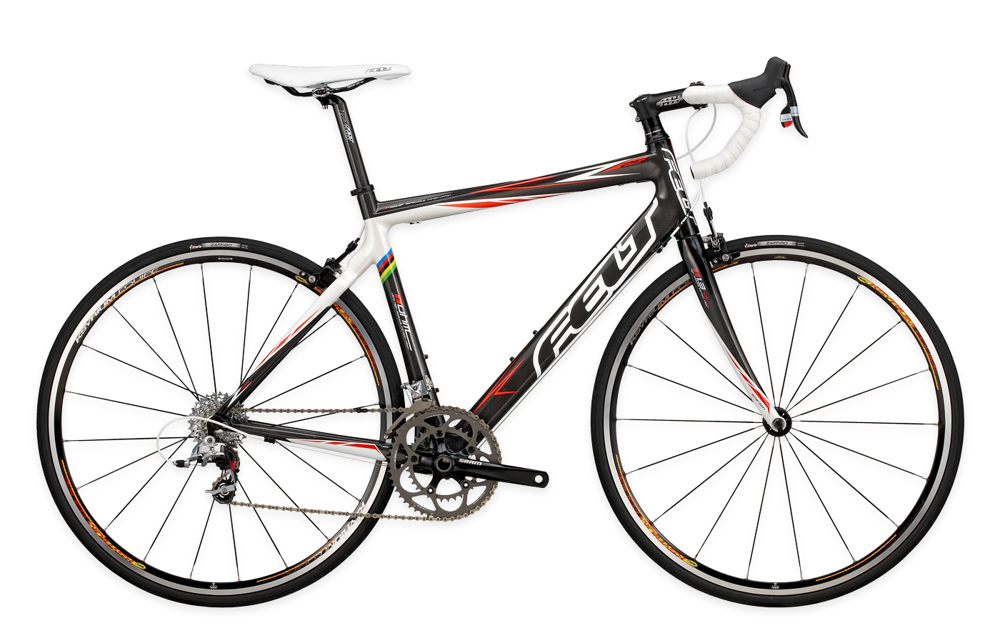
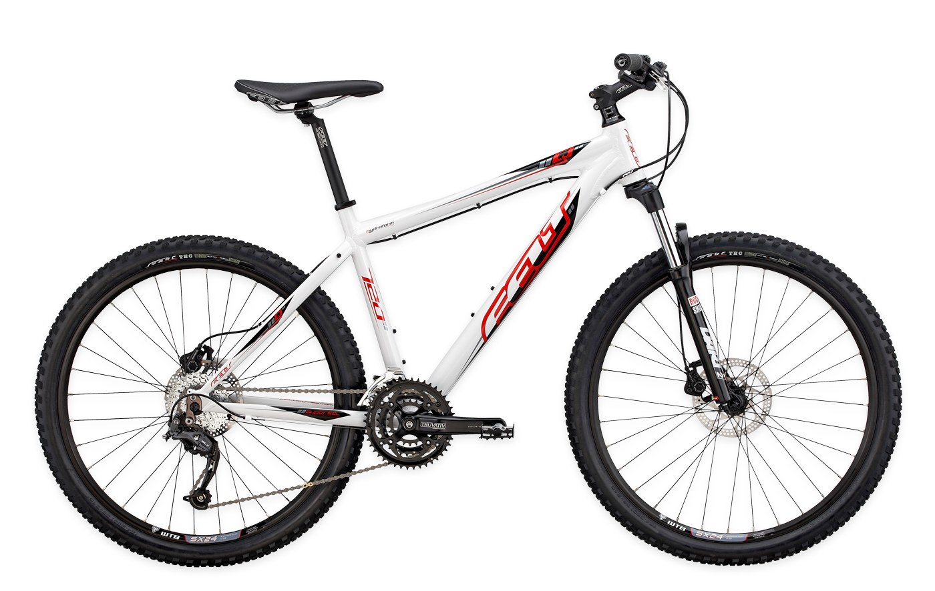
baik

Slide 3
baik
You could be excused for thinking that “baik”, pronounced “bah-ik”, is the Indonesian word for “bicycle”.
If you believe that, then you really have been taken for a ride!
The adjective “baik” can mean “fine”, “good” or “well” in Indonesian.

Slide 4
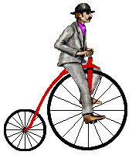
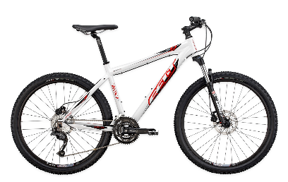
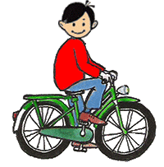
baik
If someone asks “Apa kabar?” (How are you?”) in Indonesian, you can reply:
“ _ saja!”
Baik-baik saja! (Just fine!)
If ever you’re not feeling all that “baik”, get on your “bike” and go for a ride.

