Slide 2
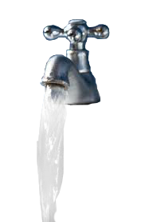
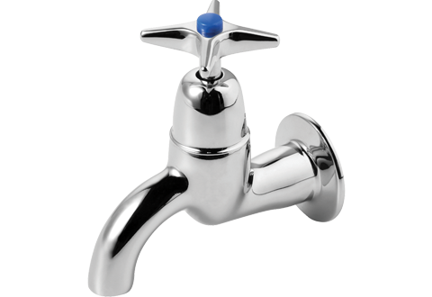
atap

Slide 3
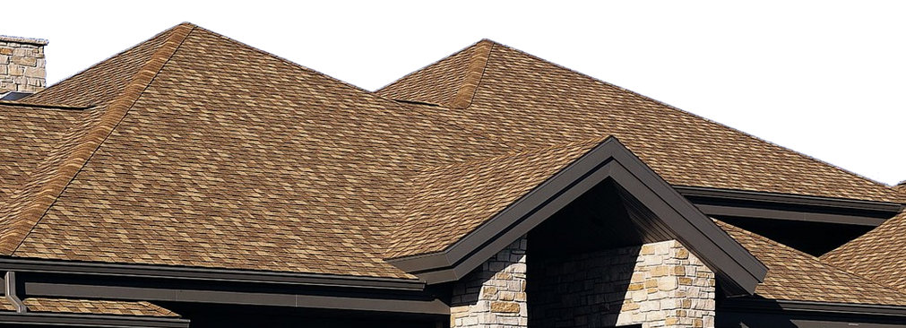
atap
You could be excused for thinking that “atap”,which is pronounced “a-tup”, means “a tap” in Indonesian.
However, “atap” actually means “roof” in Indonesian.

Slide 4
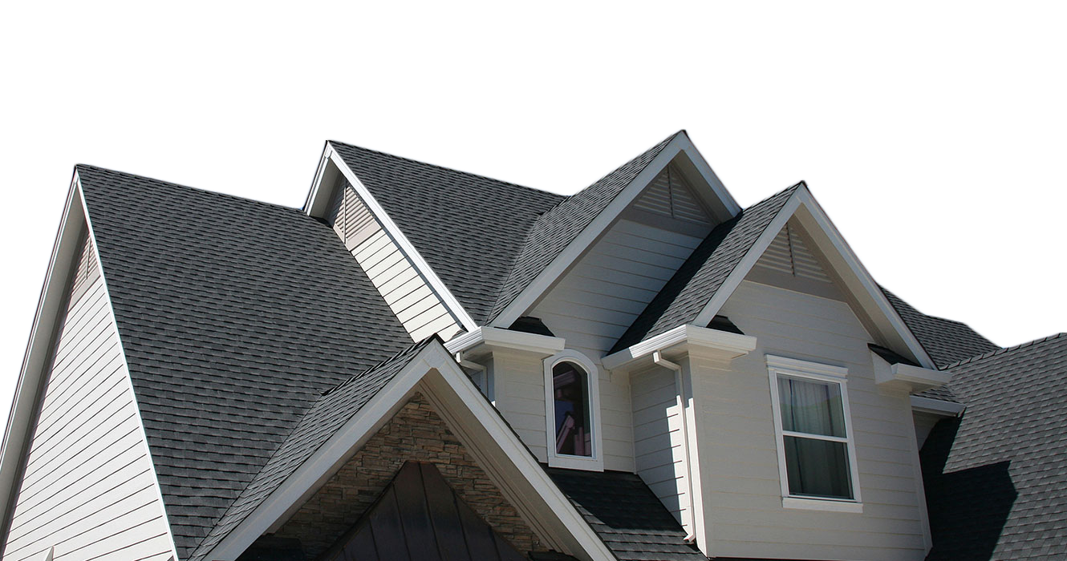
atap
If you wanted to install a tap in your roof, I suppose you could call it “atap-atap”.

Slide 5
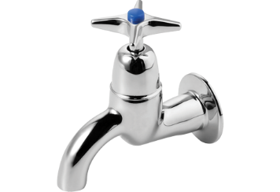
atap
And remember, it’s every person’s dream to one day have “atap” over their heads.

