Slide 1
Adjectives
Describe
Him or Her

Slide 2
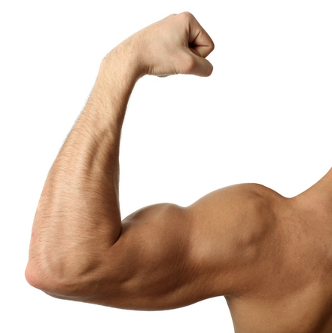
Kuat

Slide 3
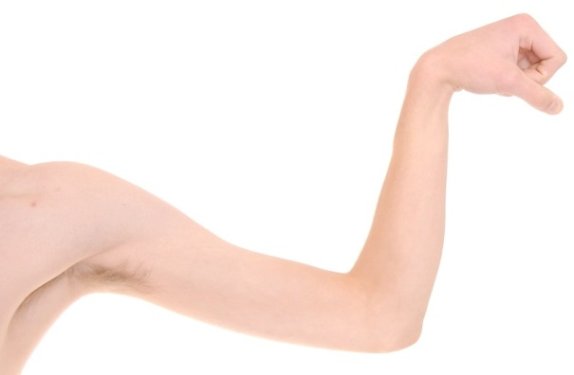
Lemah

Slide 4
Baik Hati

Slide 5
Jahat and Kejam

Slide 6
Cantik or Cakep

Slide 7
Ganteng or Cakep

Slide 8
Manis or Mungil

Slide 9
Kurus or Langsing

Slide 10
Gemuk

Slide 11
Serius

Slide 12
Lucu

Slide 13
Malas

Slide 14
Rajin

Slide 15
Bodoh

Slide 16
Pintar or Pandai

Slide 17
Tinggi and Pendek

