Slide 1
Using Standards To Plan For Teaching And Assessment
By
Lester Ford
Senior Education Officer QSA

Slide 2
IML Criteria & Standards
Levels 4-6
Criterion: conveying meaning
Speaking
Writing
Criterion: comprehension
Reading
Listening

Slide 3
IML Criteria & Standards
Levels 4-6
So, aims/objectives of your courses: - understand & communicate in the language
NOT translation
NOT do grammatical exercises

Slide 4
Criteria Based - Standards Referenced Assessment
Criteria are the properties, dimensions or
characteristics of a subject by which student
performances are appraised
Standards describe the various levels of
performance on a criterion. They state what the student can actually do

Slide 5
IML Criteria & Standards Levels 4 – 6
Highly proficient Speaking :
Extensive range of vocabulary and grammatical features on
familiar topics, used with a high level of accuracy
Very good pronunciation, intonation, rhythm and emphasis
Exchange initiated and maintained with little or no
prompting
Register is appropriate to the situation
Demonstrated sensitivity to cultural contexts
Ability to convey connected thoughts and ideas coherently and flexibly
Ability to convey intention and attitude effectively
Ability to use appropriate pause fillers, non-verbal
techniques and repair strategies effectively

Slide 6
IML Criteria & Standards Levels 4 – 6
Highly proficient Reading :
Comprehensive understanding of the text(s)
including gist and detail
Full grasp of meaning of familiar and unfamiliar,
complex and idiomatic language
Clear distinction between main and minor points
Ability to deduce meaning from context
Ability to draw appropriate conclusions
Appreciation of speaker's tone, attitude and
purpose
Demonstrated understanding of cultural meanings

Slide 7
BUT...
To achieve this level of competence, knowledge of grammar is essential

Slide 8
Criteria & standards tell you:
What you expect students to be able to do
How well they should be able to do it
& therefore...
What you need to teach, and/or
What learning experiences you need to
design

Slide 9
Backward Mapping
Know where you are going
- Synthesizing task
• What will students do with the language?
How do you get there?
- Enhancing tasks
• How will students learn the language?
Where do you start?
- Orientating tasks
• How do you link to current knowledge/interest?

Slide 10
Planning sequence
Decide what you want students to do/know/achieve
Decide what functions/grammar/vocab/script are
needed
Decide how students will learn it / you will teach it
Prepare resources / aids / handouts / activities
Design lesson sequence
when do certain things happen?
when are resources distributed?
who does what?

Slide 11
“Methods”
Grammar-translation method
Traditional
Learn the grammar & translate texts
Immersion
Learn other subjects in the language

Slide 12
“Methods” [2]
Audiolingual method
Behaviourist, popular in 60s & 70s
Learn a language through habit-formation
Need to practise drills until new habit learned
Communicative Language Teaching
Learn a language through communication
‘Real life’ or 'lifelike' activities
Less emphasis on formal grammar

Slide 13
'How' to teach languages
The basic principle... is learning in communicative contexts. Communication encompasses the exchange and negotiation of meaning between individuals through the use of verbal and nonverbal symbols in aural, oral, visual and written modes. It involves both receptive and productive processes through the application of language learning to new situations. (Syllabus sect. 4)

Slide 14
To communicate effectively, students should:
have an understanding of the linguistic features of the language being used
become familiar with strategies used to understand and use language
develop intercultural understanding.

Slide 15
Communication
Linguistic competence
Sociolinguistic competence
Pragmatic competence

Slide 16
Communication
Linguistic competence
- Lexical
- Syntax
- Phonetic
Sociolinguistic competence
- Sociocultural parameters of language use. e.g formal or informal ways of greeting
Pragmatic competence
- Putting functions into practice
- Mastering discourse; shaping language for different genres, using cohesion (structural linking) and coherence (meaningful relationships in language)
- compensating for difficulties, e.g. comprehension checks, paraphrase, conversation fillers

Slide 17
Types of comprehension
Global comprehension: to gain a very general idea of the text as a whole - situation, subject, intention, main information/idea
Essential comprehension: everything except secondary details
Focused comprehension: locating a restricted amount of information
Interpretative comprehension: elaborating
hypotheses on the sense of the text
Total comprehension: grasp of all elements

Slide 18
Reading purposes
Skimming: glancing over a text to grasp the
essential
Scanning: searching for a precise piece of
information
Extensive reading: of longer texts, often for
pleasure and a global understanding
Intensive reading: of shorter texts, focusing
on precision and detail
All different from translating

Slide 19
Listening purposes
To hear: trying to hear noises in the silence of the
night
To select: searching for clues according to the
sound
To identify: regrouping various bits of information
to make a holistic judgement [e.g. of a person]
To reformulate: analysing & synthesizing the
elements of a message
To do: to select the elements necessary for action

Slide 20
The communicative approach (1)
Uses research from many fields; not tied to one theory
Favours meaning, but balanced with syntax
Inferred principles :
- all communication has a social purpose - learner has something to say or find out
- activities that involve real communication promote learning
- activities in which language is used for carrying out meaningful tasks promote learning
- language that is meaningful to the learner promotes learning

Slide 21
The communicative approach (2)
Is learner-centred & responsive to learners' interests
Language is acquired through interactive communicative
use that encourages the negotiation of meaning
Genuinely meaningful language use is emphasized,
involving unpredictability, taking risks and making choices
Authentic language from the TL is used
Language forms are always treated within a
communicative context, never in isolation from use
Individual discovery of forms and structures is encouraged
Listening, speaking, reading & writing are integrated in a
whole-language approach

Slide 22
The communicative approach (3)
Ideal for beginners; starts with oral;
communication learned through functions
Advanced learners: more emphasis on writing & analysis of discourse
Allows choice of material relevant to learners:
age, interest, ability, existing knowledge,
integrated projects, etc
Closest to reality; quickest route to
communicating in TL

Slide 23
The communicative approach (4)
Motivation of teacher: choice of resources,
learning experiences relevant to learners
More student control over own learning
Results:
- 30 yrs ago: « I studied French for 4 years & I
can't say anything »
- Now: leave 1st lesson able to communicate
basic information

Slide 24
Why use authentic documents
Partial substitute for TL community: newspaper &
magazine articles, poems, songs, games, news,
visual representations [videos, film, media
downloads]
More motivating for learner (real language for real
purposes), especially if current & relevant to age
& interest
Allows for independent learning
Goes far beyond the textbook
Is less likely to contain mistakes (beware material
on net)

Slide 25
Your attitude to mistakes is?
They show lack of learning They show ineffective teaching
They show student willingness to communicate in spite of risks
They are inevitable in all language use, and part of language learning

Slide 26
Alignment
Aligning teaching, learning
and assessment

Slide 27
Bloom's Taxonomy
Knowledge
Comprehension
Application
Analysis
Synthesis
Evaluation

Slide 28
Anderson's Revised Taxonomy
Remembering
Understanding
Applying
Analysing
Evaluating
Creating

Slide 29
The Taxonomies
Knowledge Remembering
Comprehension Understanding
Application Applying
Analysis Analysing
Synthesis Evaluating
Evaluation Creating
Compare these with the standards descriptors

Slide 30
IML Criteria & Standards Levels 4-6
Highly proficient Reading :
Comprehensive understanding of the text(s)
including gist and detail
Full grasp of meaning of familiar and unfamiliar,
complex and idiomatic language
Clear distinction between main and minor points
Ability to deduce meaning from context
Ability to draw appropriate conclusions
Appreciation of speaker's tone, attitude and
purpose
Demonstrated understanding of cultural meanings

Slide 31
Receptive skills

Slide 32
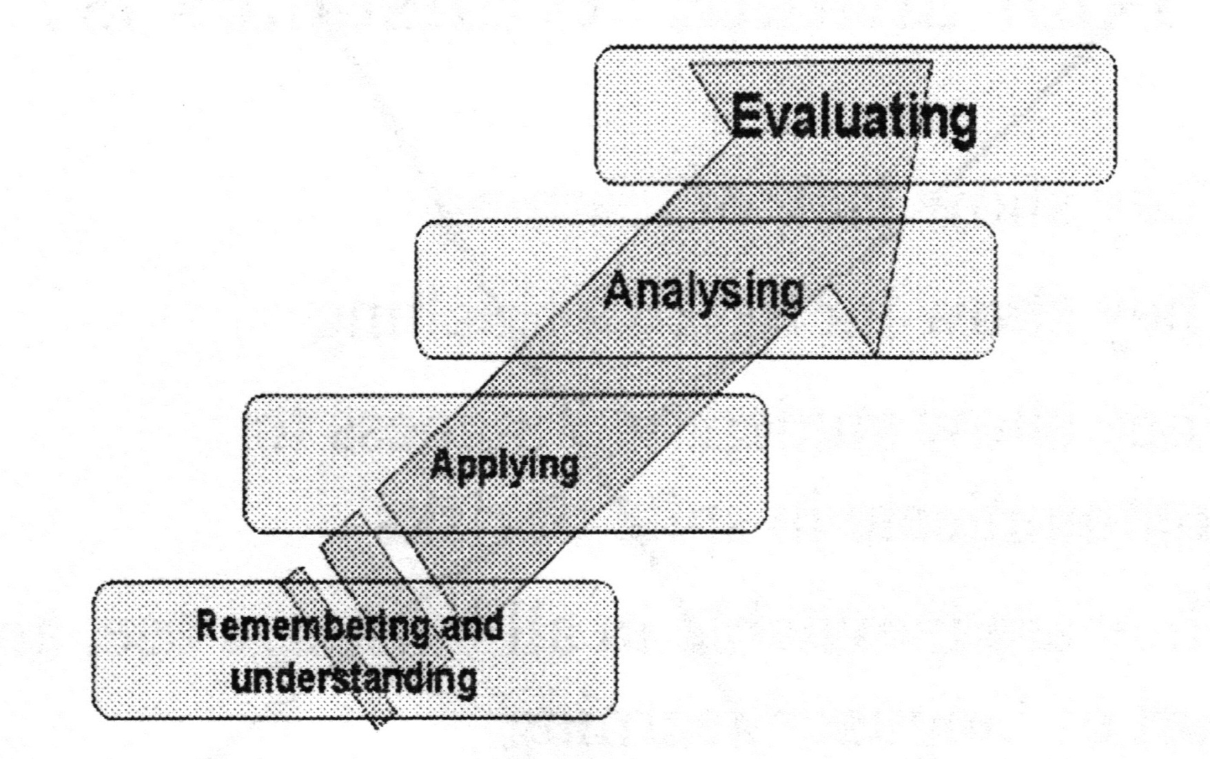

Slide 33
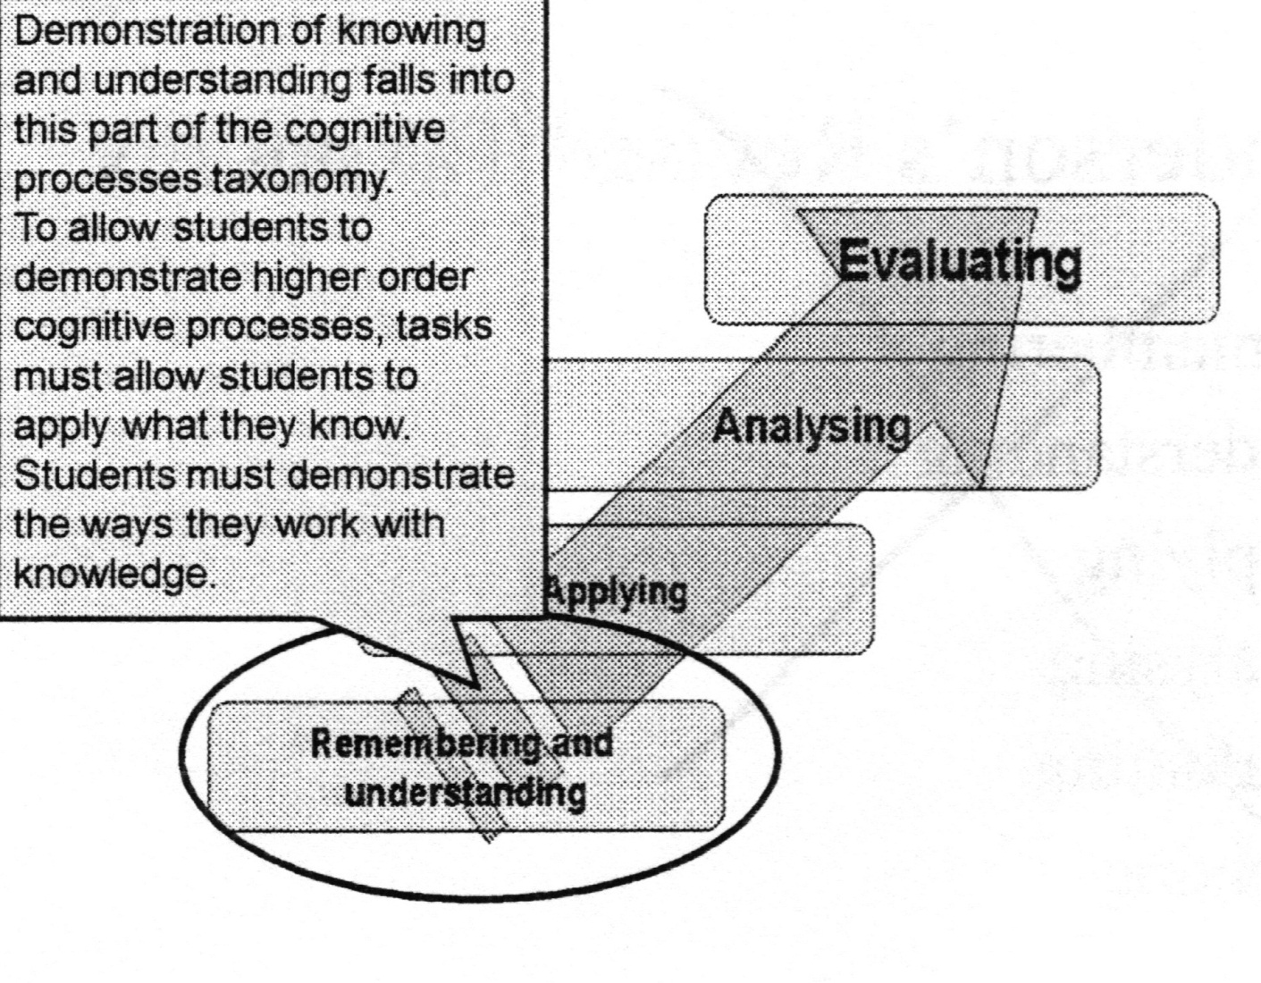

Slide 34
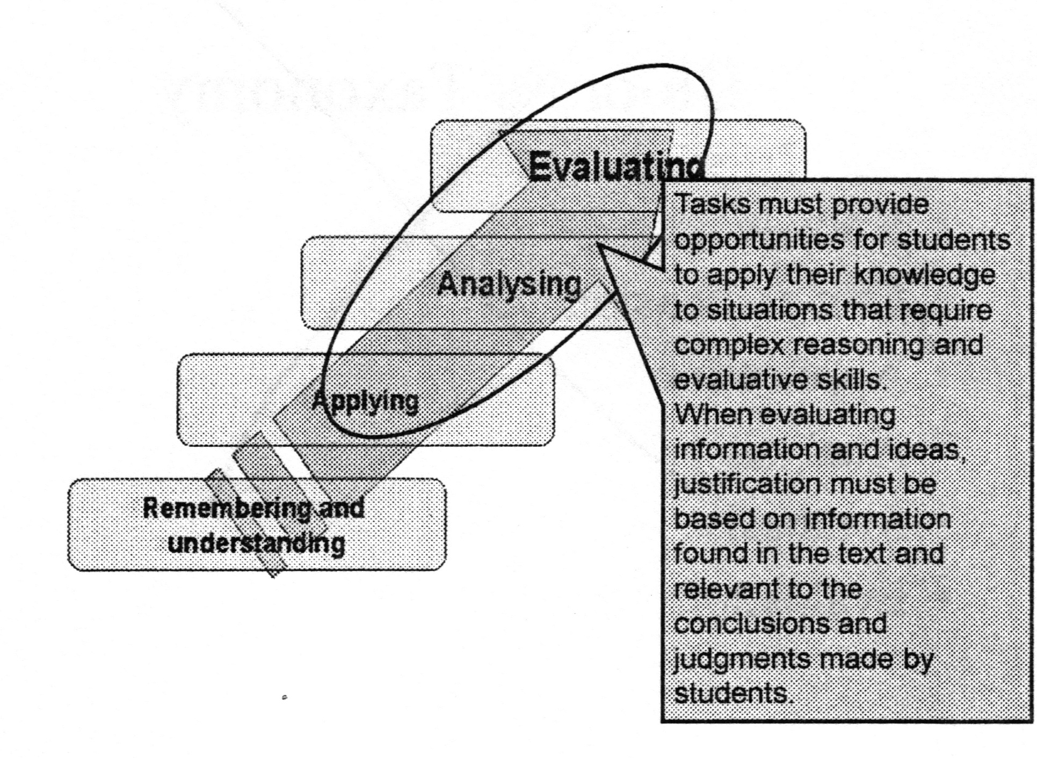

Slide 35
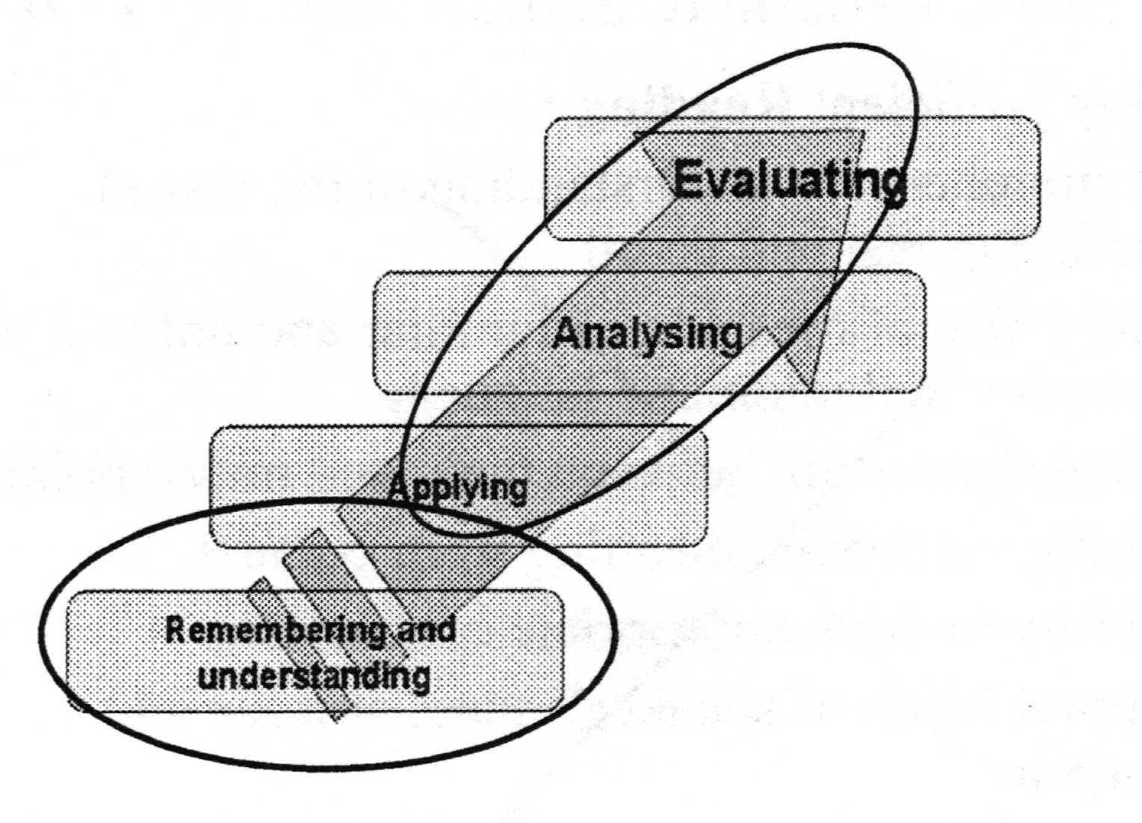

Slide 36
Productive skills

Slide 37
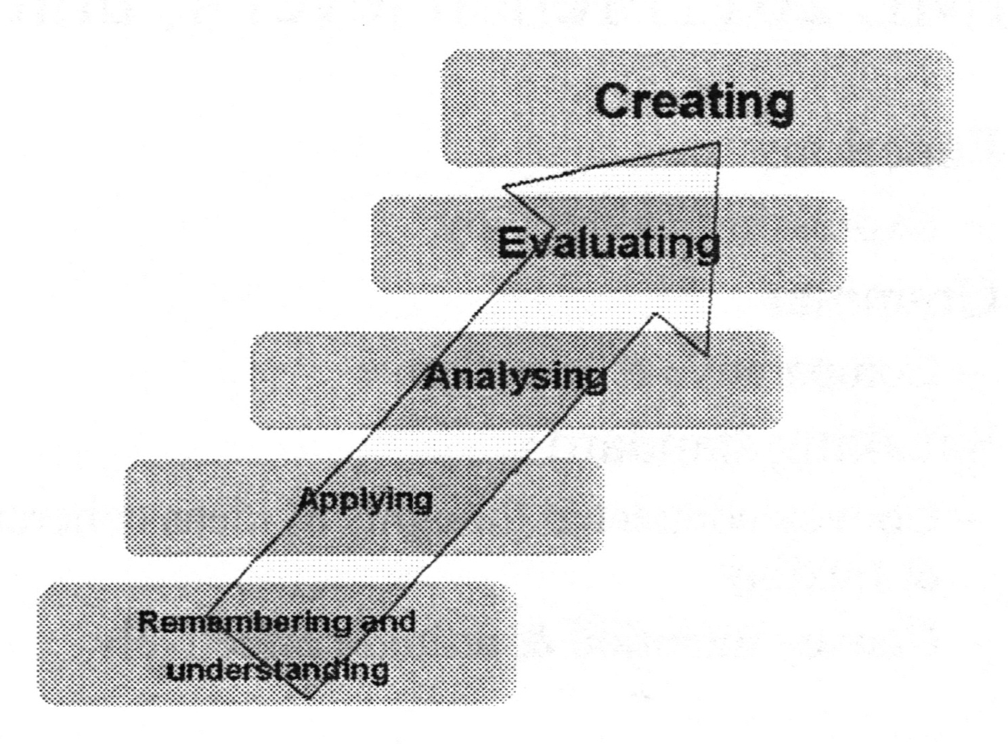

Slide 38
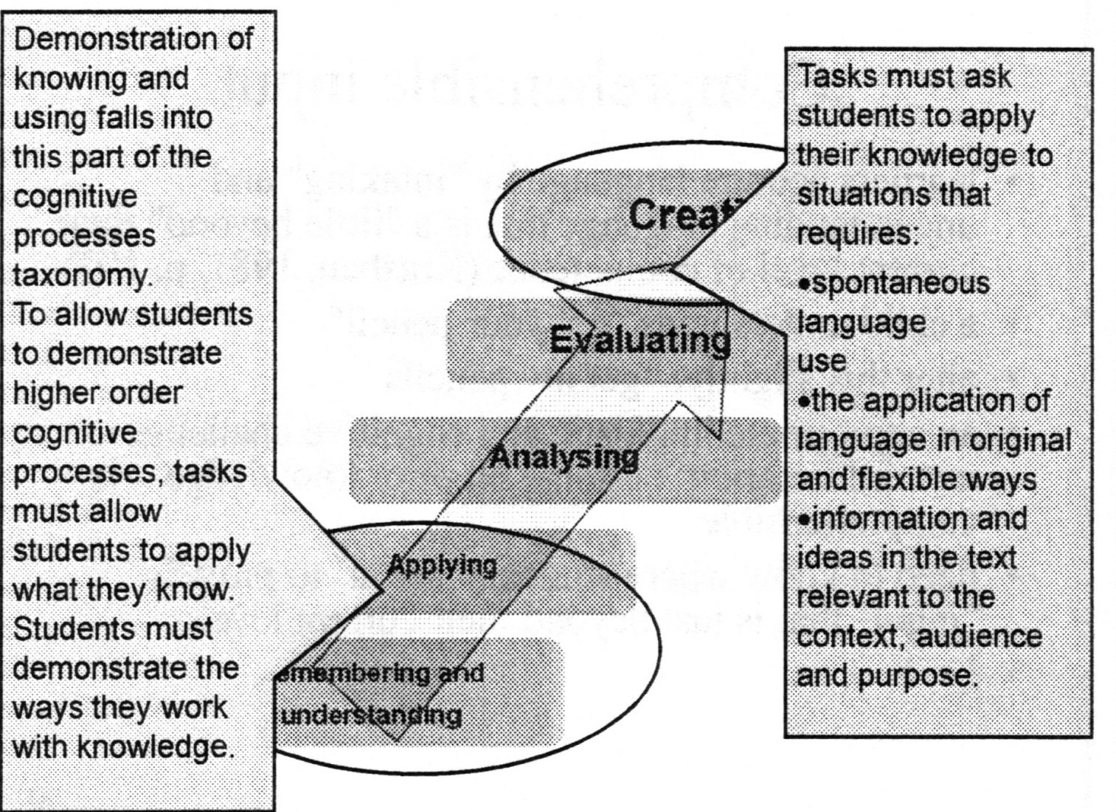

Slide 39
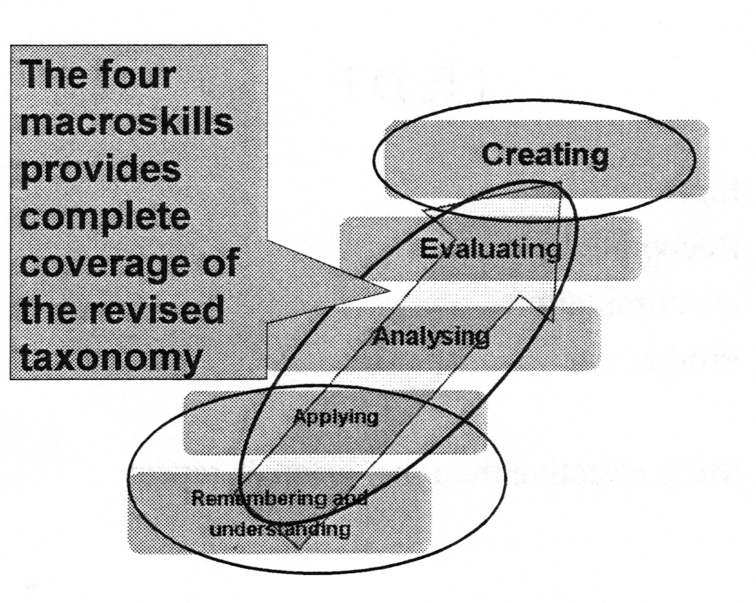

Slide 40
Lifelong learners [your students] are:
knowledgeable persons with deep
understanding
complex thinkers
creative persons
active investigators
effective communicators
participants in an interdependent world
reflective and self-directed learners

Slide 41
A lesson could contain:
Anticipatory set
Objective [what] (linked to your course guides)
Rationale [why]
Your job will be [students' tasks]
Input [new learning, main info of lesson]
Modelling [the finished article/process]
Checking for understanding [can be incorporated with
modelling, checks that most students can go on]
Guided practice [students practice with help, a 'trial
run', remediation for some]
Independent practice [students able to work -
success!]

Slide 42
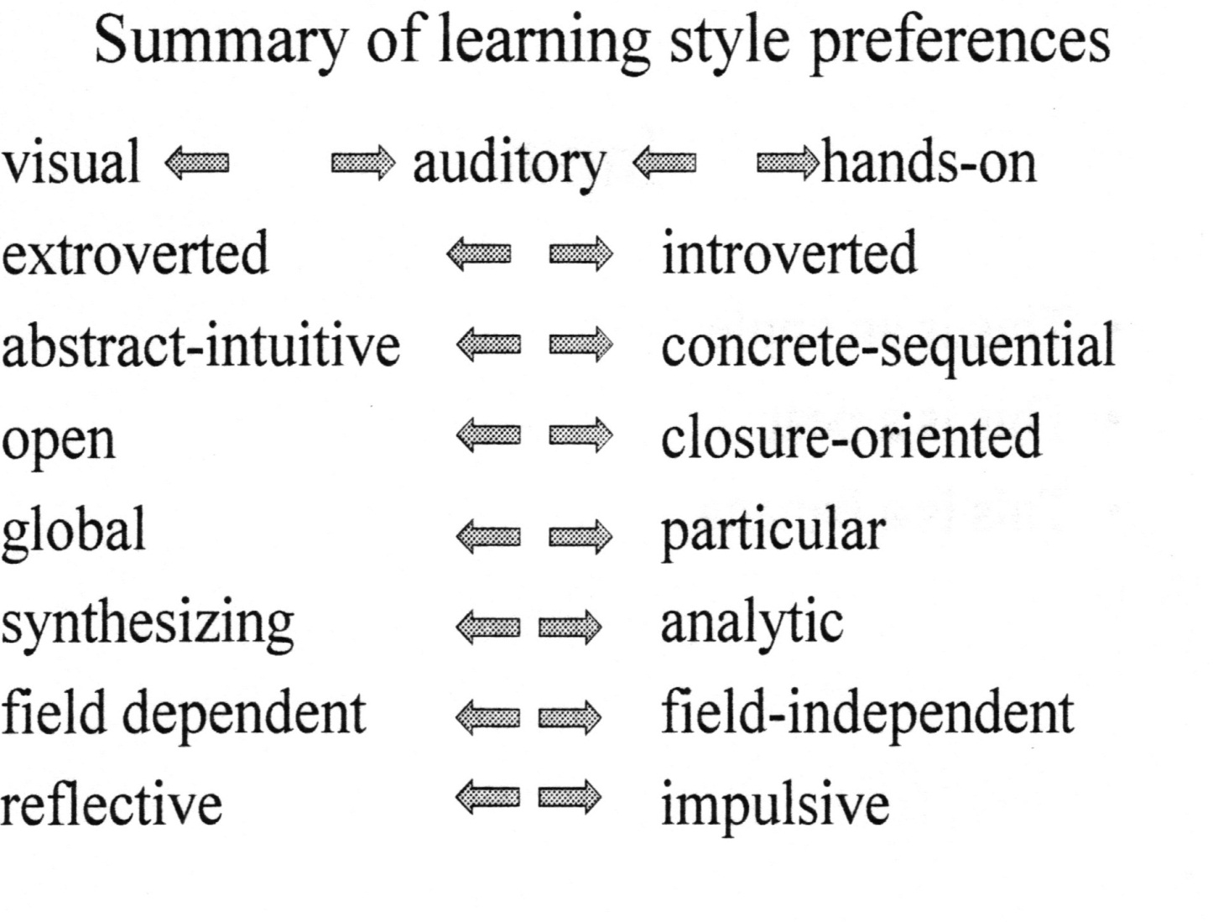

Slide 43
Comprehensible input
learners acquire language by "intaking" and
understanding language that is a "little
beyond" their current level of competence
(Krashen. 1981. p. 103)
a child understands "get your pencil"
alter this slightly: "get my pencils"
an appropriate linguistic and cognitive challenge - new information building on prior knowledge – is comprehensible
need to know where students 'are at" to provide
"input" that is just beyond their current level
i+ 1

Slide 44
IML 2011 French Level 4, Unit 4
Functions
- Expressing sadness/joy
Grammar
- Comparative & superlative
Speaking standard
- Convey connected thoughts & ideas coherently & flexibly
-Convey intention & attitude effectively

Slide 45
From course outline to student use
Ecstatic More
Jubilant Less
Happy …as…
Content Happy as a pig
Unhappy How do we teach it?
Sad How do students understand
Depressed it enough to use it?

Slide 46
IRDP
Input
Recognition
Discrimination
Production
More effective than just listen & repeat

Slide 47
Input
This is an apple
This is a pear
This is a banana

Slide 48
Recognition
Is this an apple? Yes/No
Is this a pear? Yes/No
Is this a banana? Yes/No

Slide 49
Discrimination
Is this an apple or a pear?
Is this a banana or an apple?
Is this a pear or a banana?

Slide 50
Production
What is this?

Slide 51
Input
Assume students know colours
The apple is red
The pear is green
The banana is yellow

Slide 52
Recognition
What colour is the apple?
- Red
What colour is the pear?
- Green
What colour is the banana?
- Yellow

Slide 53
Discrimination
What is red, the apple or the pear?
- The apple
What is green, the banana or the pear?
- The pear
What is yellow, the banana or the apple?
- The banana

Slide 54
Production
What is red?
- The apple
What is green?
- The pear
What is yellow?
- The banana

Slide 55
Practising language forms
Written exercises should relate to students' need to write
Listening exercises should contain the type of language that is comprehensible to them
TL should be practised in the context of potential 'authentic' use, but should also be relevant to individual students' needs

Slide 56
Student activities of low value
Choral/individual repetition
Reading aloud from textbook
Reading out dialogues/role-plays
Translating
Copying from board/book
Word-searches

Slide 57
Student activities of mixed value
Drill-like activities
Student-student dialogue
Receiving grammatical explanations

Slide 58
Student activities of high value
Listening to the TL
Replying to questions in the TL
Asking questions in the TL
Engaging in dramatic activities
Increasing active/passive vocabulary
Reading silently
Relating language to social/cultural context
Doing written work of an error-free nature

Slide 59
Assessment instruments & learning experiences should be consistent
Realistic, communicative, in the four
macroskills
promote the use of spontaneous language
cover a variety of genres
show a balance across the macroskills

Slide 60
Variety of tasks
A variety of tasks, which include inquiry and/or problem solving, promotes the progressive development of the four macroskills [syllabus 5]

Slide 61
Suggested speaking learning &
assessment tasks
Contexts could include:
one-to-one interview or conversation
small-group discussion
debate
formal speech/presentation
responding to stimuli, such as pictures, maps, cartoons, brochures
role play

Slide 62
Realistic
Examples of Speaking:
Student-teacher discussion
"Talk about a holiday or travel you have experienced. Mention both positive and negative aspects."

Slide 63
Suggested writing learning &
assessment tasks
Texts could include:
personal letter
email
personal journal entry
formal letter
invitation & reply note
magazine article

Slide 64
Suggested writing learning &
assessment tasks (continued)
Texts could include:
commentary on a series of pictures
imaginative response to stimulus material
expository, argumentative or persuasive writing on some topical issue in response to stimulus material such as simple written texts or audio visual material

Slide 65
Realistic
Example of Writing:
Personal letter/email
"Assume you are writing to a TL friend with whom you correspond regularly. Talk about events you anticipate happening during the rest of this year and your plans for next year. Find out what your friend anticipates doing and also catch up on some gossip since your last contact."

Slide 66
Summary
Real language for real purposes
Focus on learner & communication
- Solving a problem; attaining a goal
- Producing something - brochure, play - Expressing opinions & own experience
Use of authentic documents
Alignment of teaching, learning, assessment

Slide 67
References
Krashen, Stephen D. Principles and Practice in Second Language Acquisition. Prentice-Hall International, 1987.
Krashen. Stephen D. Second Language Acquisition and Second Language Learning. Prentice-Hall International, 1988.

Slide 68
References
Evelyne Berard; L'Approche Communicative: theorie et pratiques; CLE International: 1991
Gabor Boldizsar (coord) An introduction to the current European context in language teaching; Council of Europe;
http://wvyw.ecml.at/documents/pub214
E2003Bold izsar.pdf
Michele Pendanx; Les Activites d'Apprentissage en Classe de Langue: Hachette. 1998

Slide 69
References
David Little & Radka Perclova:The European
Language Portfolio: a guide for teachers and
teacher trainers; Council of Europe;
http://www.culture2.coe.int/portfolio//documents/
ELPguide_teacherstrainers.pdf
Joe Shells; La Communication dans la Classe de
Langue: Conseil de 1'Europe: 1993
Cadre Europeen Commun de Reference pour les
Langues: Conseil de 1'Europe; 2000(?)
http://www.culture2.coe.int/portfolio/docurnents/c
adrecommun.pdf

