Slide 2
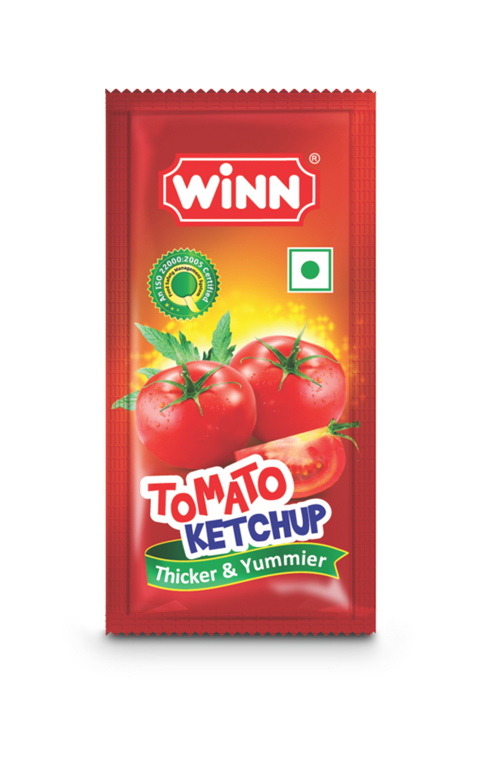
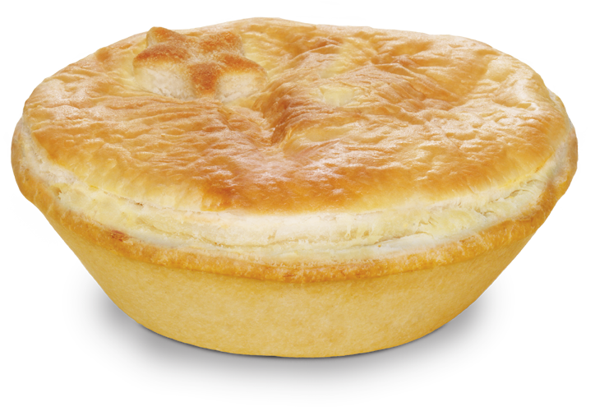
tupai

Slide 3
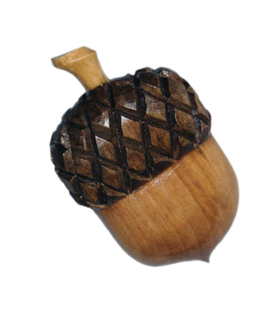
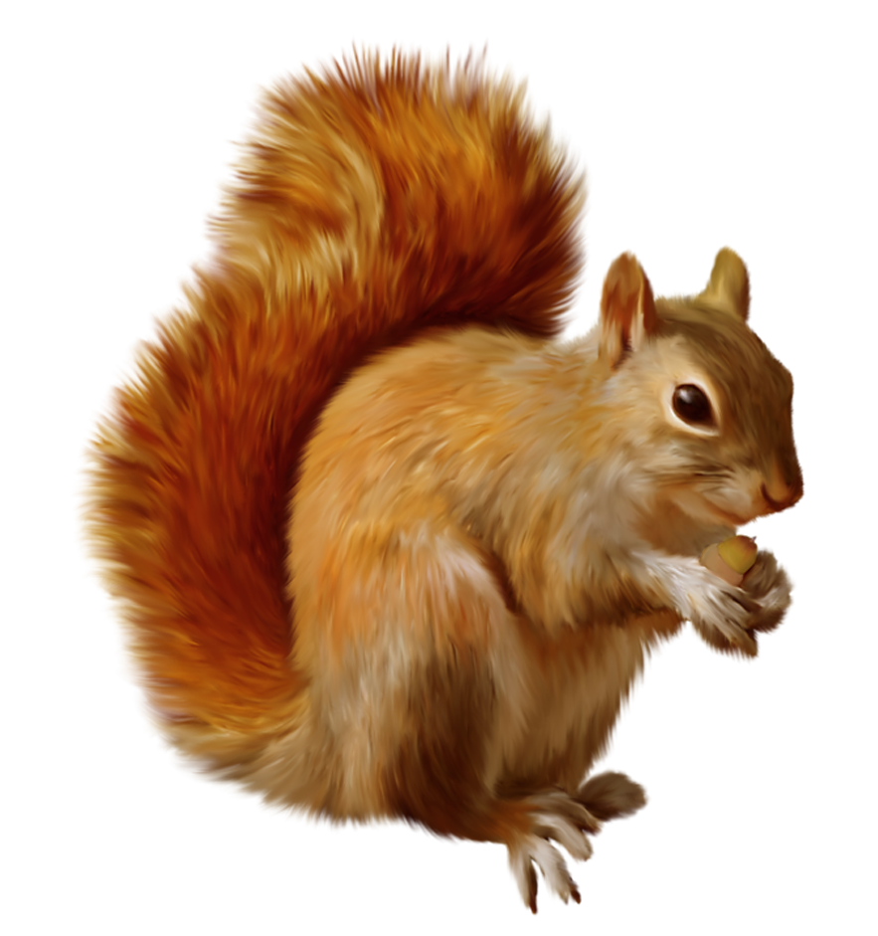
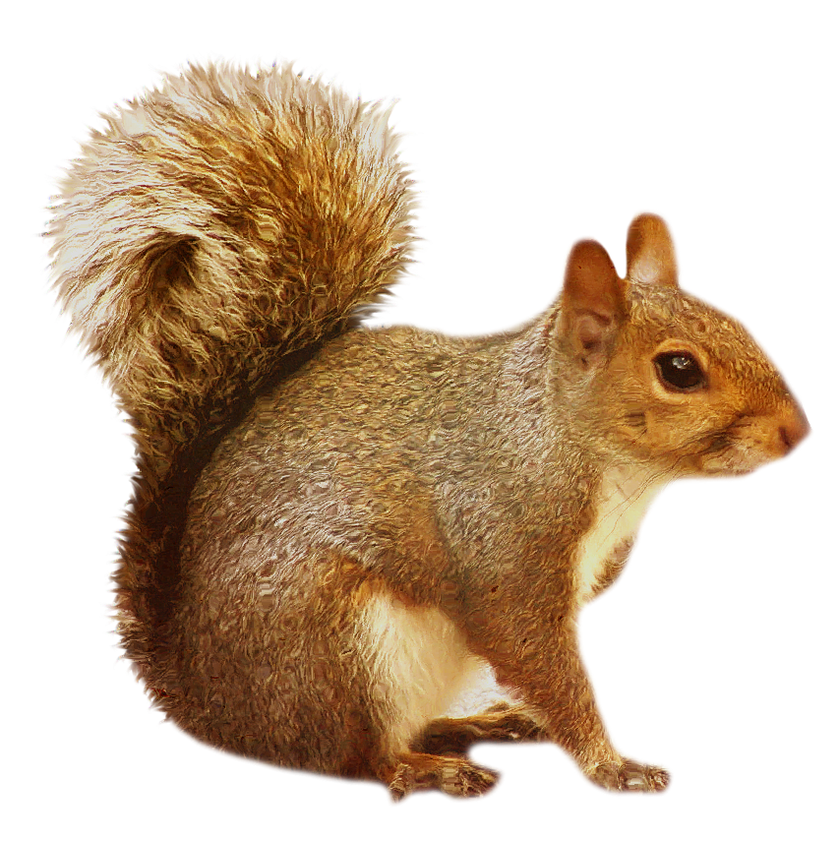
tupai
You could be excused for thinking that “tupai”, pronounced “two-pie”, is the Indonesian for “two pies”.
Sorry I can’t appease you, but the noun “tupai” means “squirrel” in Indonesian!

Slide 4
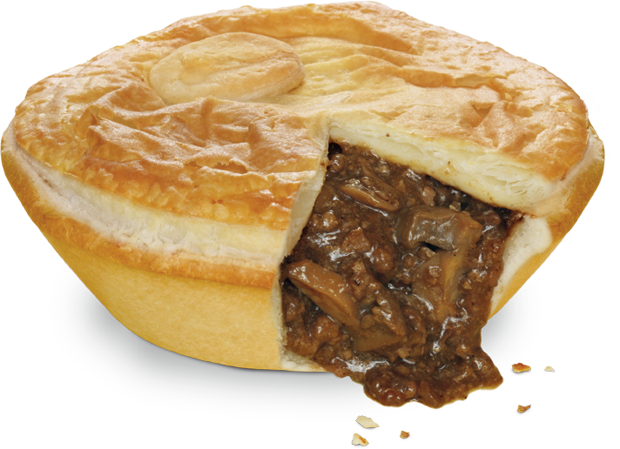
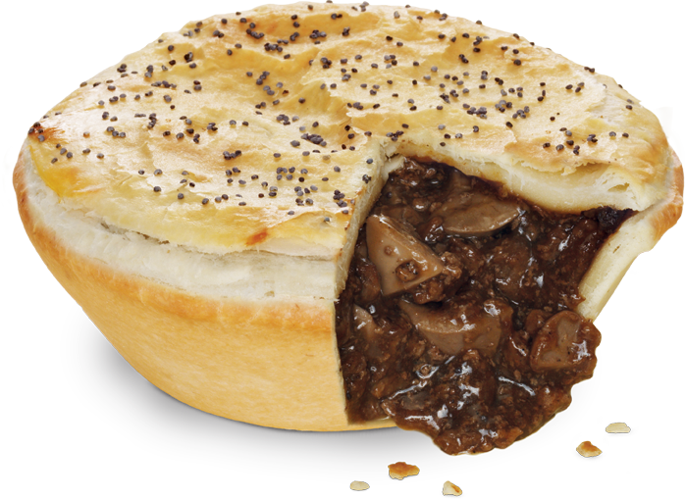
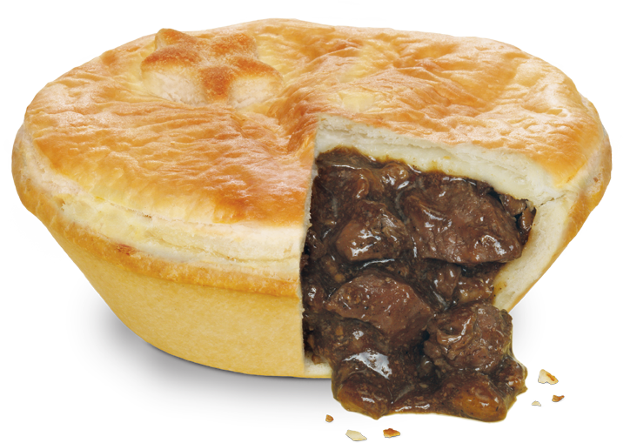
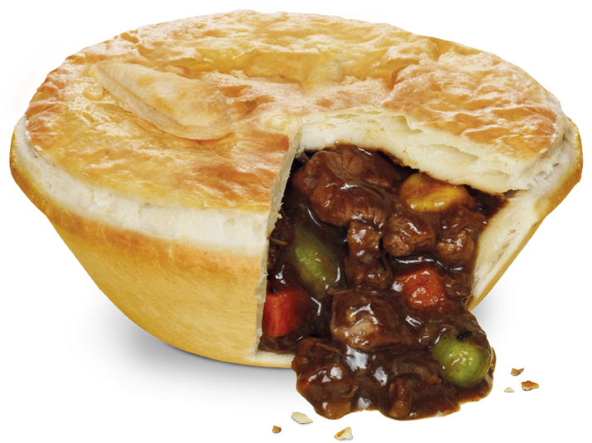
tupai
With all the different ingredients in pies these days, it wouldn’t surprise me to find some “tupai” in a pie or two!

Slide 5
tupai

