Slide 2
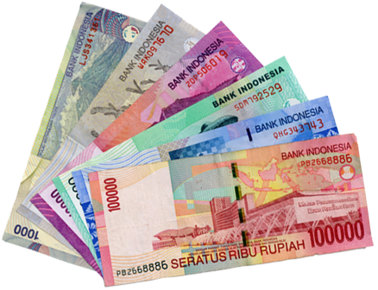
tunai

Slide 3
tunai
In Indonesia people prefer to use cash when shopping whereas in Australia we tend to use credit cards for even small purchases.
The word “tunai” means “cash”. When shopping in Indonesia you may see the sign “TUNAI SAJA” which means “CASH ONLY”.

