Slide 2
tukul

Slide 3
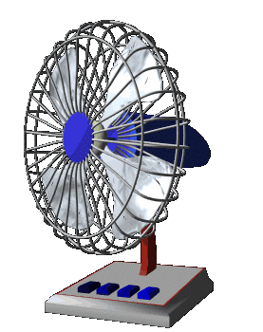
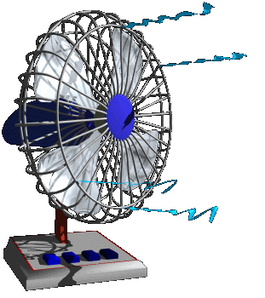
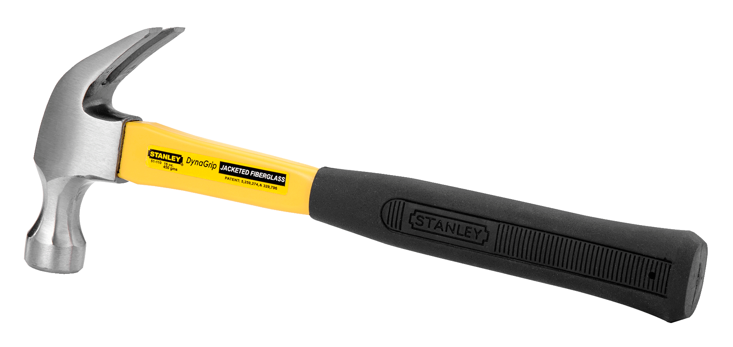
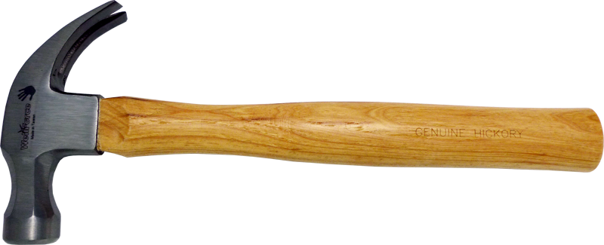
tukul
You probably think that “tukul”, pronounced “took-ool”, means “too cool” in Indonesian, right?
Sorry to put a “nail” in that idea, but the noun “tukul” means “hammer” in Indonesian.

Slide 4
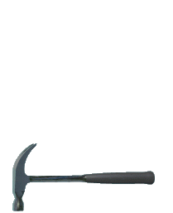
tukul
I've found that if I “hammer” you with the Word Of The Day it will help you “nail” the Indonesian language and make you “too cool”.

