Slide 2
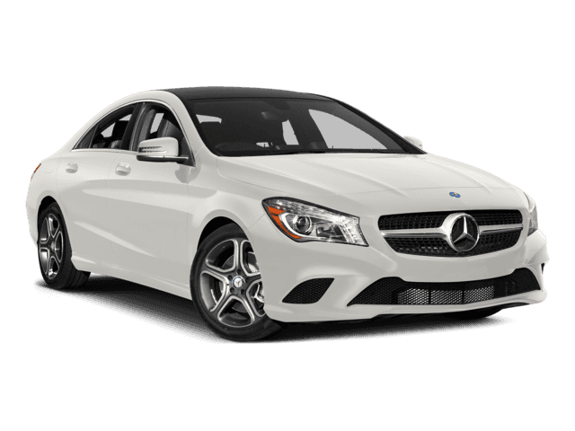
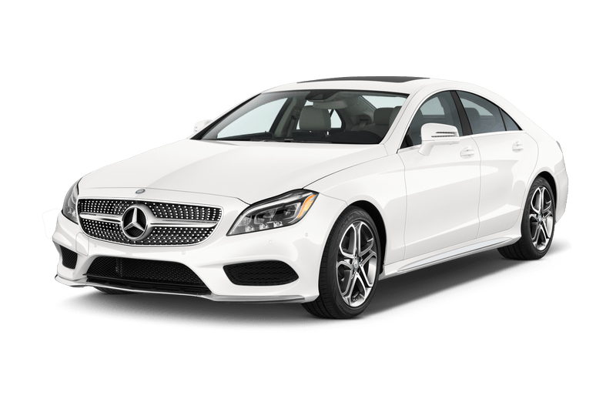
tukar

Slide 3
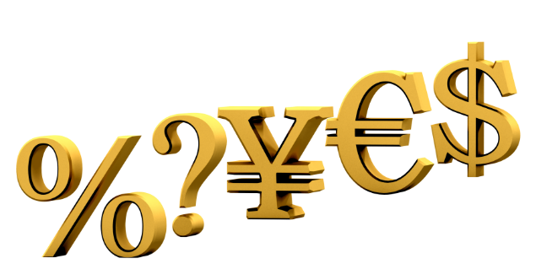
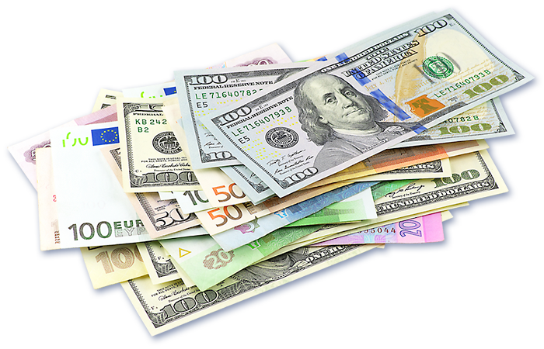
tukar
You are probably thinking that “tukar”, pronounced “took-car”, is the Indonesian word for “two cars”, right? Sorry, but you are heading down a dead-end road if you think that!
The verb “tukar” means “to exchange” in Indonesian.

Slide 4
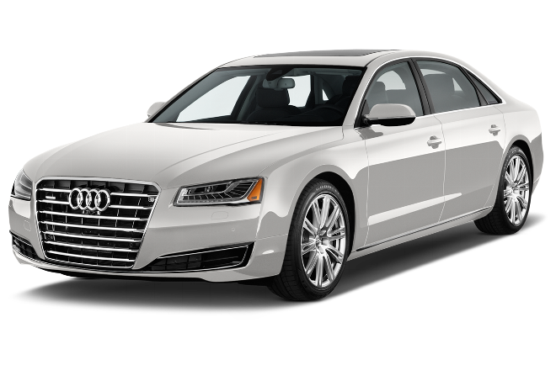
tukar
If you still want “two cars”, how about if you “tukar” one of the Mercedes for a new 2016 Audi A8 ?

