Slide 2
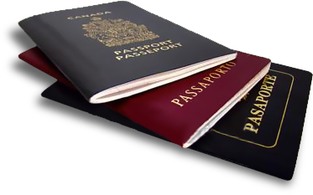
tua

Slide 3
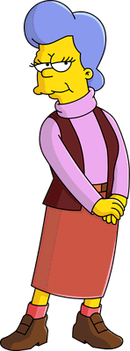
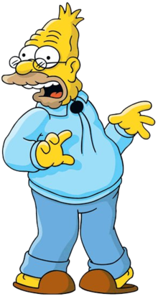
tua
You are probably thinking that “tua”, pronounced “tour”, is the Indonesian word for “tour”, right?
Sorry to spoil your vacation but the adjective “tua” means “old” in Indonesian.
Don’t let your age get in the way! You’re never too “tua” to go on a “tour”!

