Slide 2
tirai

Slide 3
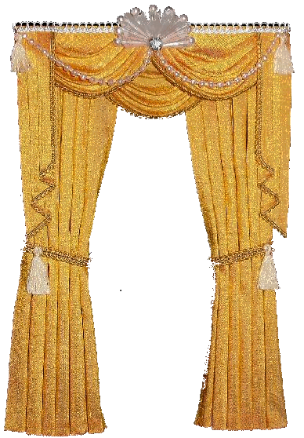
tirai
I guess you’re thinking that “tirai”, pronounced “tear-eye”, means “to cry” in Indonesian, right?
Well, wipe away those tears because it means nothing of the sort.
The noun “tirai” means “curtain” in Indonesian.

Slide 4
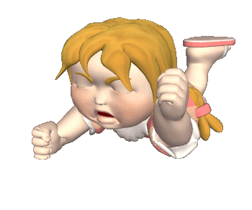
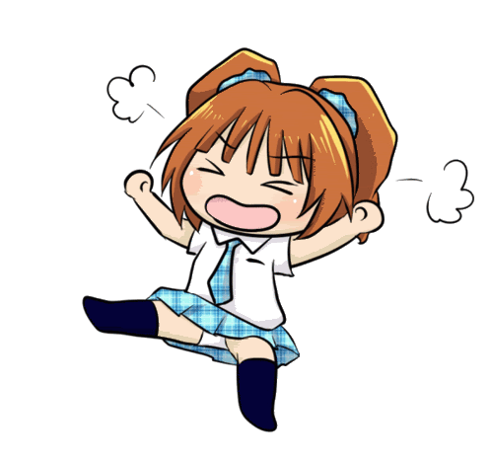
tirai
So, please let’s turn off the waterworks and draw the “tirai” on the tantrums.

