Slide 2
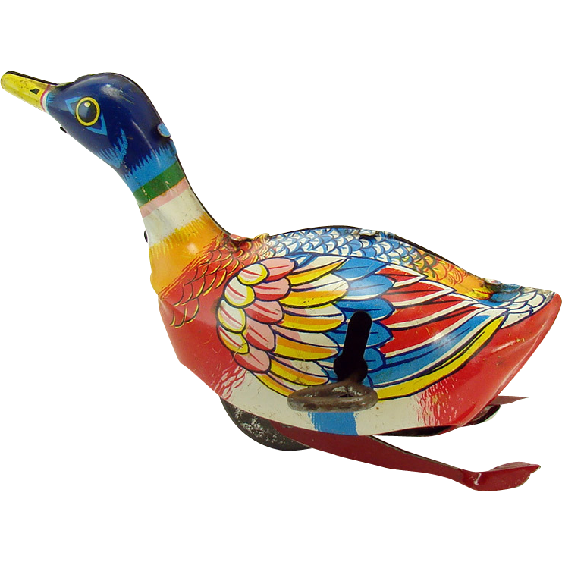
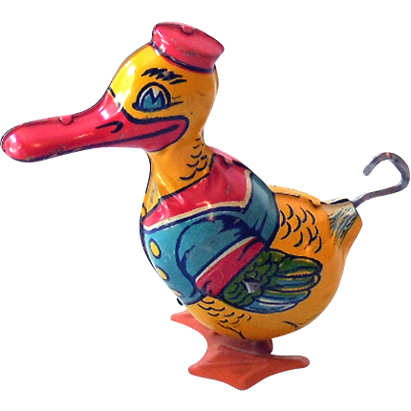
tindak

Slide 3
tindak
You are probably thinking that “tindak”, pronounced “tin-duck”, is the Indonesian for “tin duck toys” or “canned duck”, right?
Sorry, but I really have to “can” that idea!
The verbs “tindak” & “bertindak” mean “to take action” in Indonesian.

Slide 4
tindak
A word of warning … sometimes when you “bertindak” you may find yourself in an unsafe situation so always be prepared to weave and “duck”.

