Slide 2
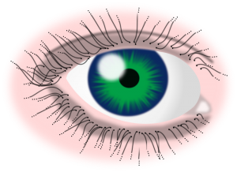
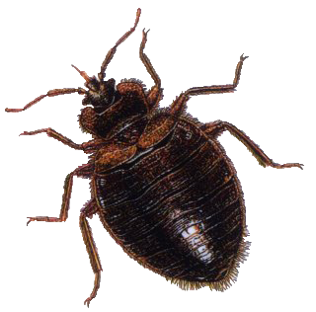
tikai

Slide 3
tikai
I’ll bet you’re thinking that “tikai”, pronounced “tick- eye”, describes a medical condition where a parasite attacks the eye, right?
Sorry to “differ” from you on this matter, but the noun “tikai” means “difference” or “distinction” in Indonesian.

Slide 4
tikai
Can you tell the “tikai” between the two eyes below? The one on the left has “tick-eye” and the one on the right has the “tick” of approval!

