Slide 2
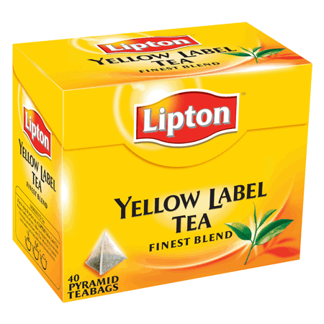
tidur

Slide 3
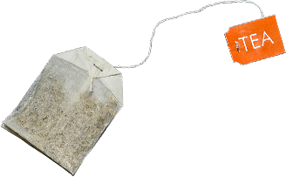
tidur
The antioxidants in “tea” may open the “door” to better health but that has nothing to do with the word “tidur” (even though it sounds very similar to “tea door”).
In Indonesian, the verb “tidur” means “to sleep”.
Now close that door and get an early night’s “tidur” so you can be wide awake for your next Indonesian class and WORD of the DAY!

