Slide 2
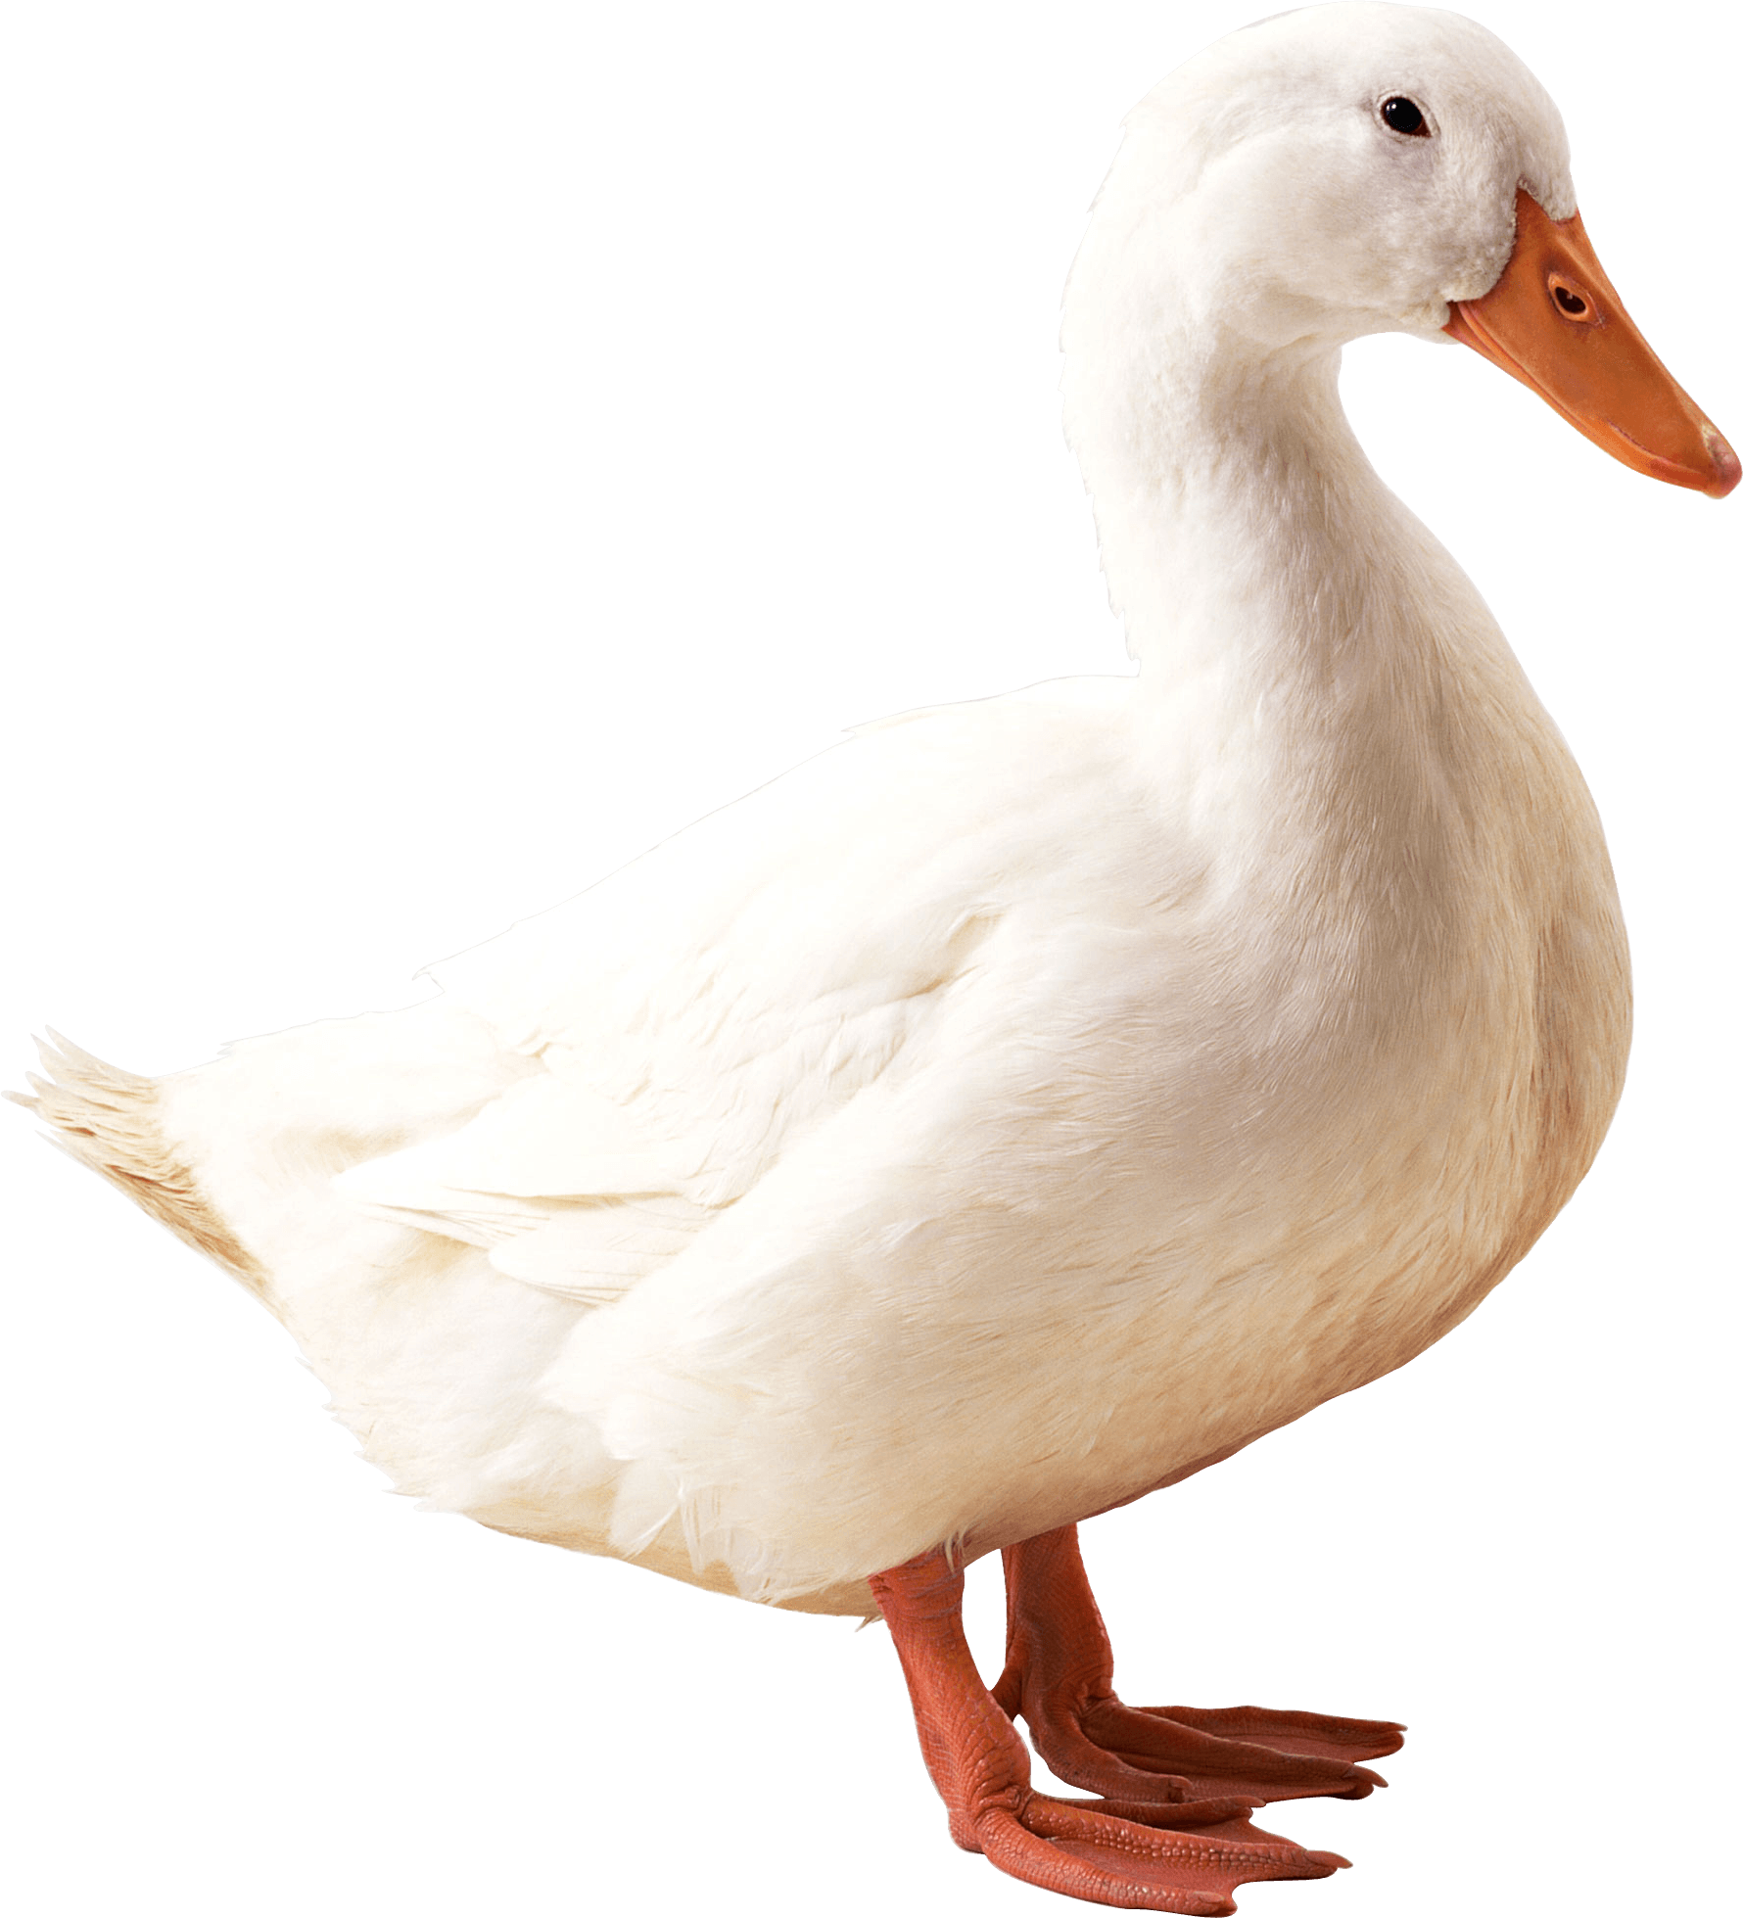
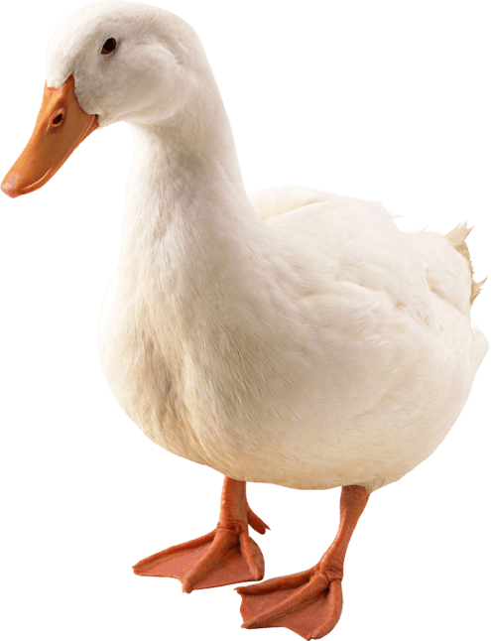
tidak

Slide 3
tidak
You are probably thinking that “tidak”, pronounced “tea-duck”, is a species of “duck” found in Indonesia, right?
No, no, no! The negator “tidak” means “no” or “not” and is used to negate verbs and adjectives in Indonesian.

Slide 4
tidak
I hope you now “know” how to say “no” in Indonesian. If you don’t “know”, you’ll never “know”!

