Slide 2
tentara

Slide 3
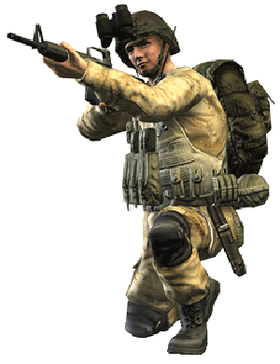
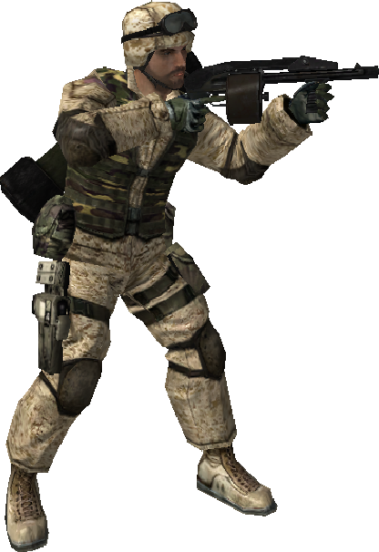
tentara
No, “tentara” is not ten photos of the American actress Tara Reid!
In Indonesian, the word “tentara” means “soldier”.

Slide 4
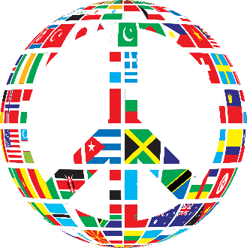
tentara
Being a peace-loving person, I’ll take 10 of Tara over “tentara” anytime.

