Slide 2
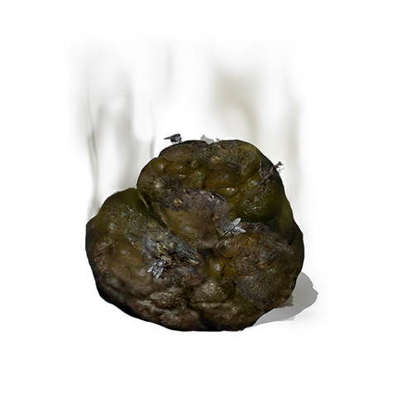
tendang

Slide 3
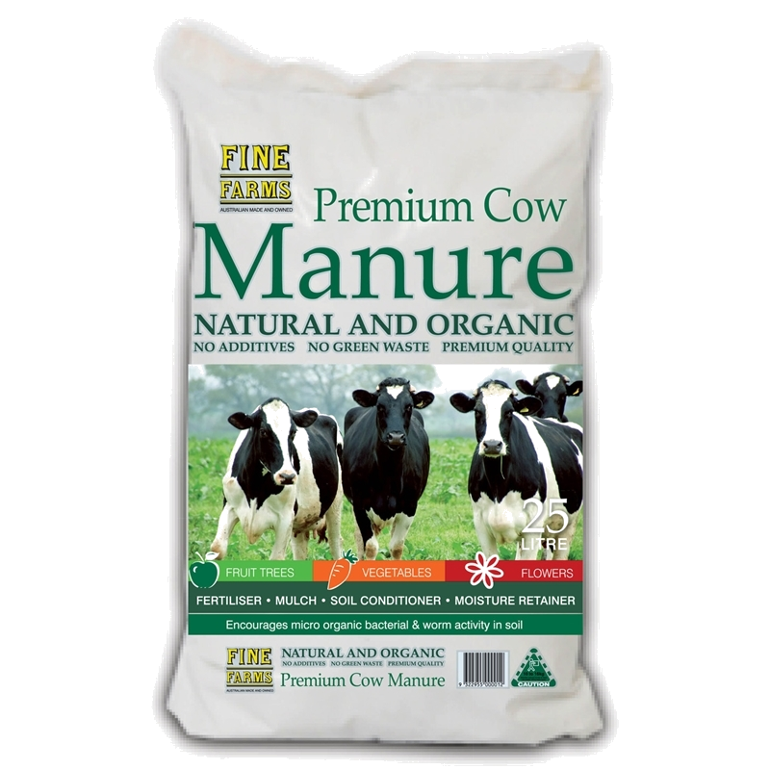
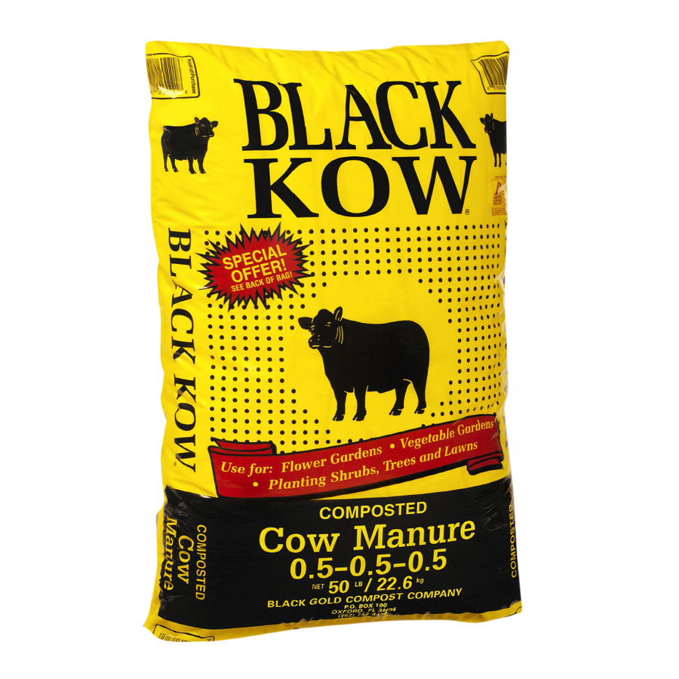
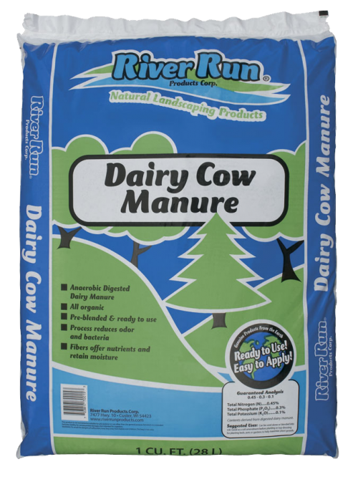
tendang
You might be thinking that “tendang”, pronounced “ten-dung”, is ten piles of cow manure, right? That’s certainly a lot of manure!
These days cow manure is prized as a valuable sustainable resource and is widely used as compost.

Slide 4
tendang
However, in Indonesian, “tendang” has nothing to do with cow manure or any other fertilizer!
In Indonesian, “tendang” is the verb for “kick”.

Slide 5
tendang
Next time you go for a kick around the paddock, be careful not to put your foot in it!

Slide 6
tendang
I’ll bet you got a real kick out of this one!

