Slide 2
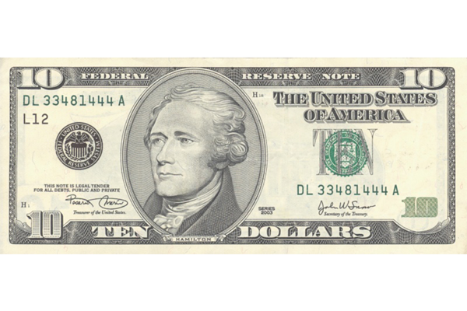
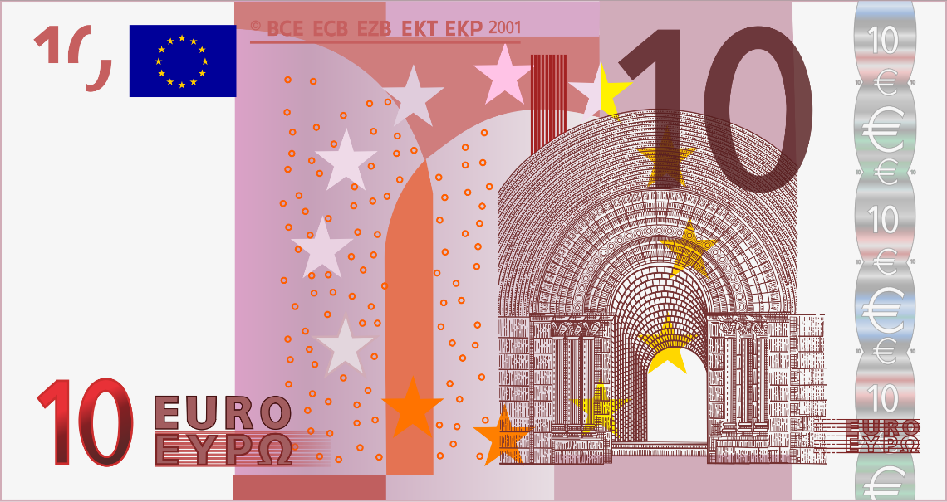
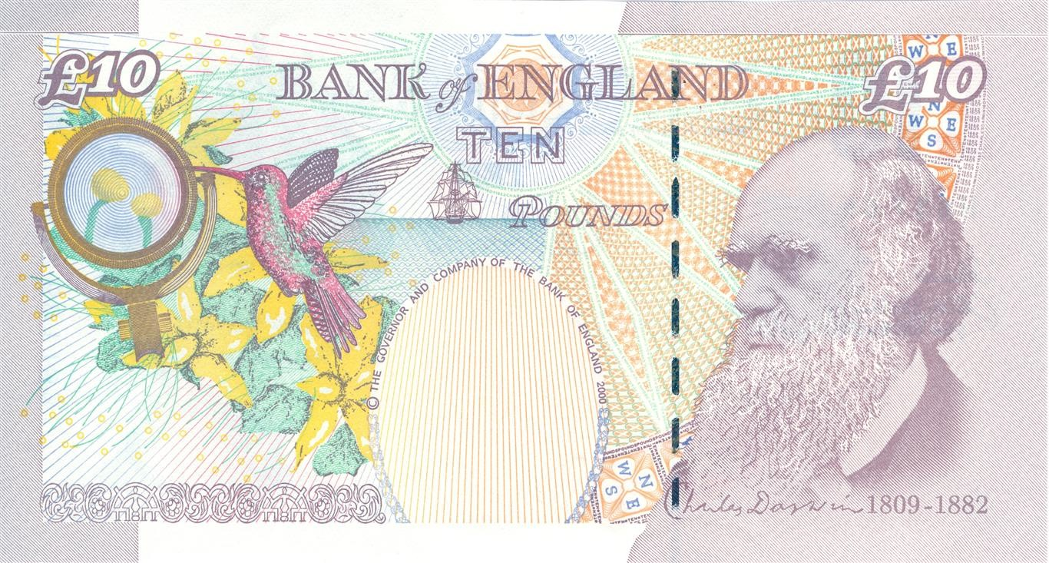
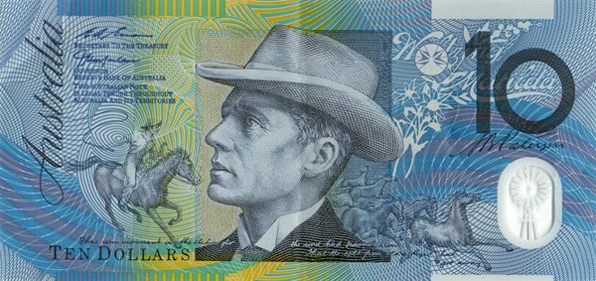
tenar

Slide 3
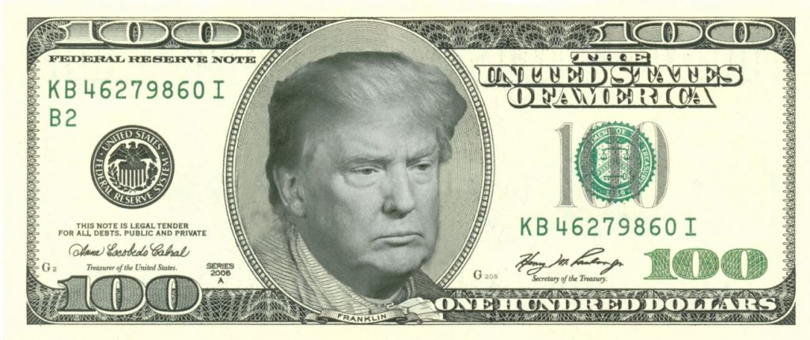
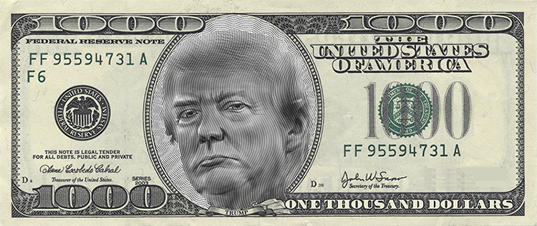
tenar
You are probably thinking that “tenar”, pronounced “ten-are”, is the Indonesian word for a “tenner”, right?
Sorry to “short change” you but the adjective “tenar” means “famous” in Indonesian.
You know you are “tenar” when your face appears on the larger notes of the United States of America.

