Slide 2
tangkis

Slide 3
tangkis
You are probably thinking that “tangkis”, pronounced “tongue-kiss”, is the Indonesian word for “French kissing”, right?
Don’t get too excited, because it is nothing of the sort!
The verb “tangkis” means to “ward-off” or “defend against” and when combined with “bulu” it forms “bulutangkis” which is the most popular Indonesian sport of “badminton”.

Slide 4
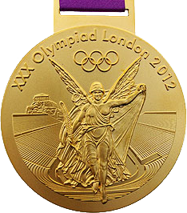
tangkis
Unlike other sports, where Indonesia usually gets “licked” on the world stage, in badminton it is Indonesia who usually dishes out the “licking”.
In fact, only China has won more Olympic gold medals in badminton than Indonesia!

