Slide 2
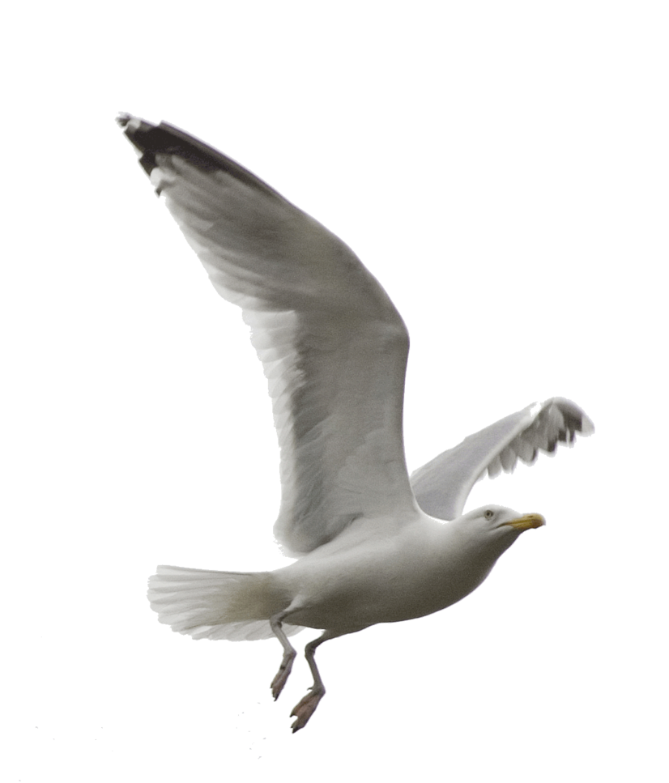
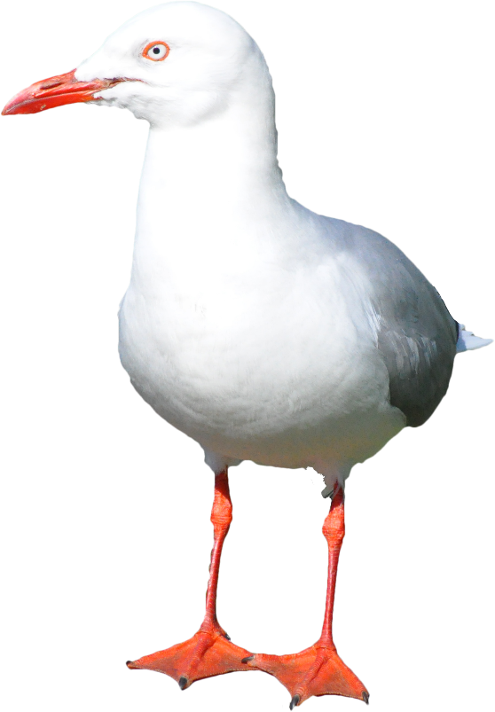
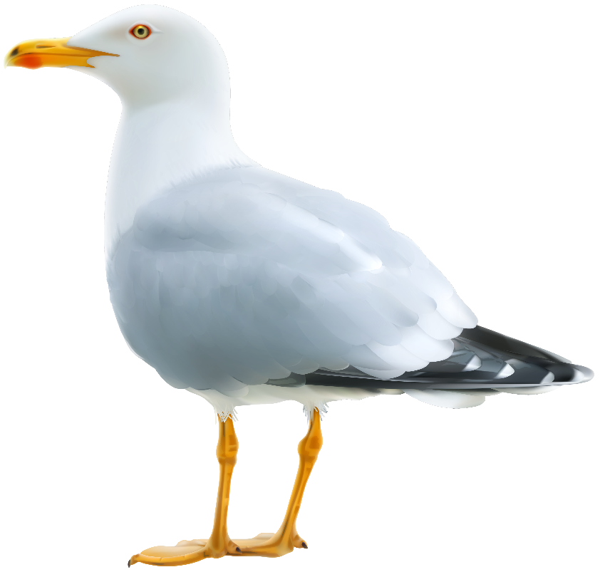
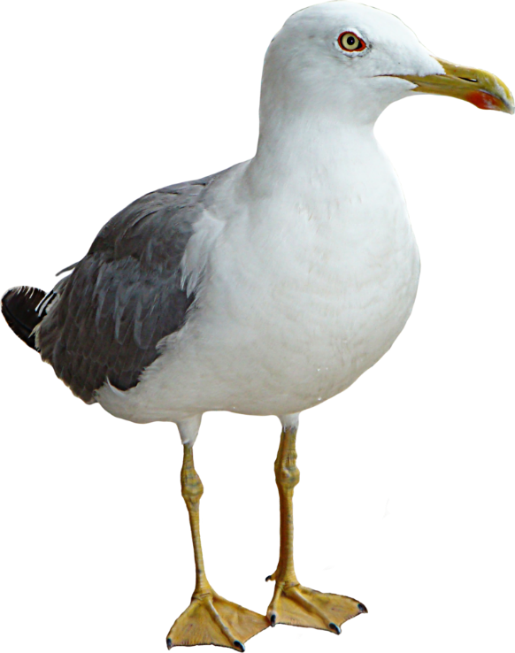
tanggal

Slide 3
tanggal
No, “tanggal”, pronounced “tongue-gull”, does not mean the tongue of a seagull! How could you possibly think that???
The word “tanggal” means “the date” in Indonesian, for example, “tanggal 17 Agustus” , which just happens to be Indonesia’s Independence Day.

Slide 4
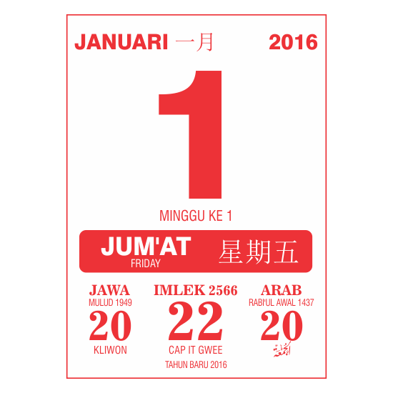
tanggal
Do you get important dates mixed up and forget what “tanggal” it is ???
Well then, you need to start bringing your School Diary to every lesson so you don’t get yourself in a “tanggal” .

