Slide 2
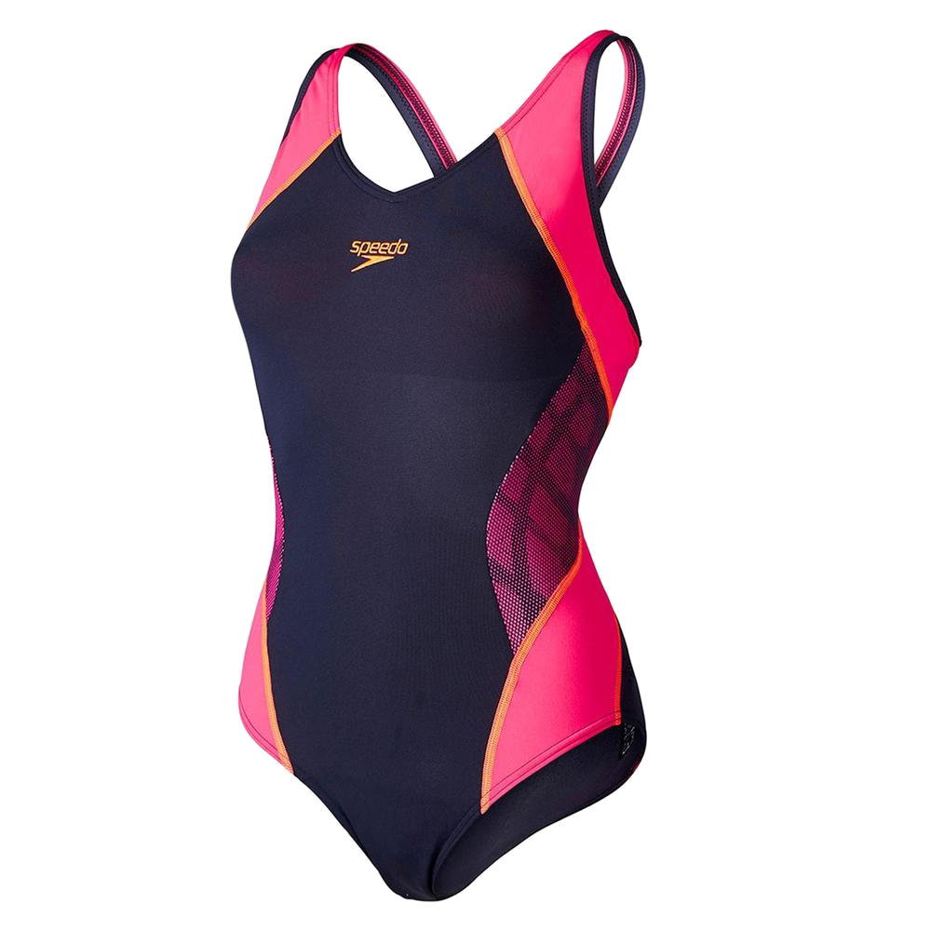
swempak

Slide 3
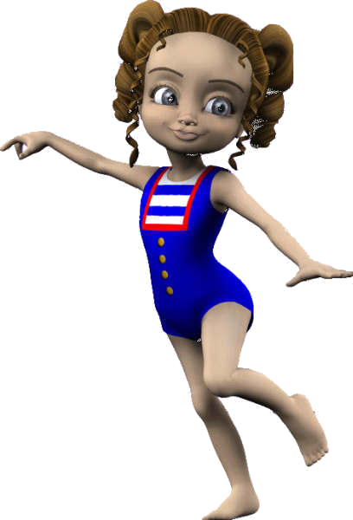
swempak
Are you a New Zealander who likes going to the local pool or to the beach for a swem? If the answer to this question is “Yes”, and you are a female, the chances are that you will be wearing a “swempak”!
In Indonesian, a “swempak” is a single-piece female swimsuit.
Next time you are at the beach with your dad, say to him, “Let’s go for a swem, Pak!”
P.S. Forgive the New Zealand pronunciation for “swim”

