Slide 2
supaya

Slide 3
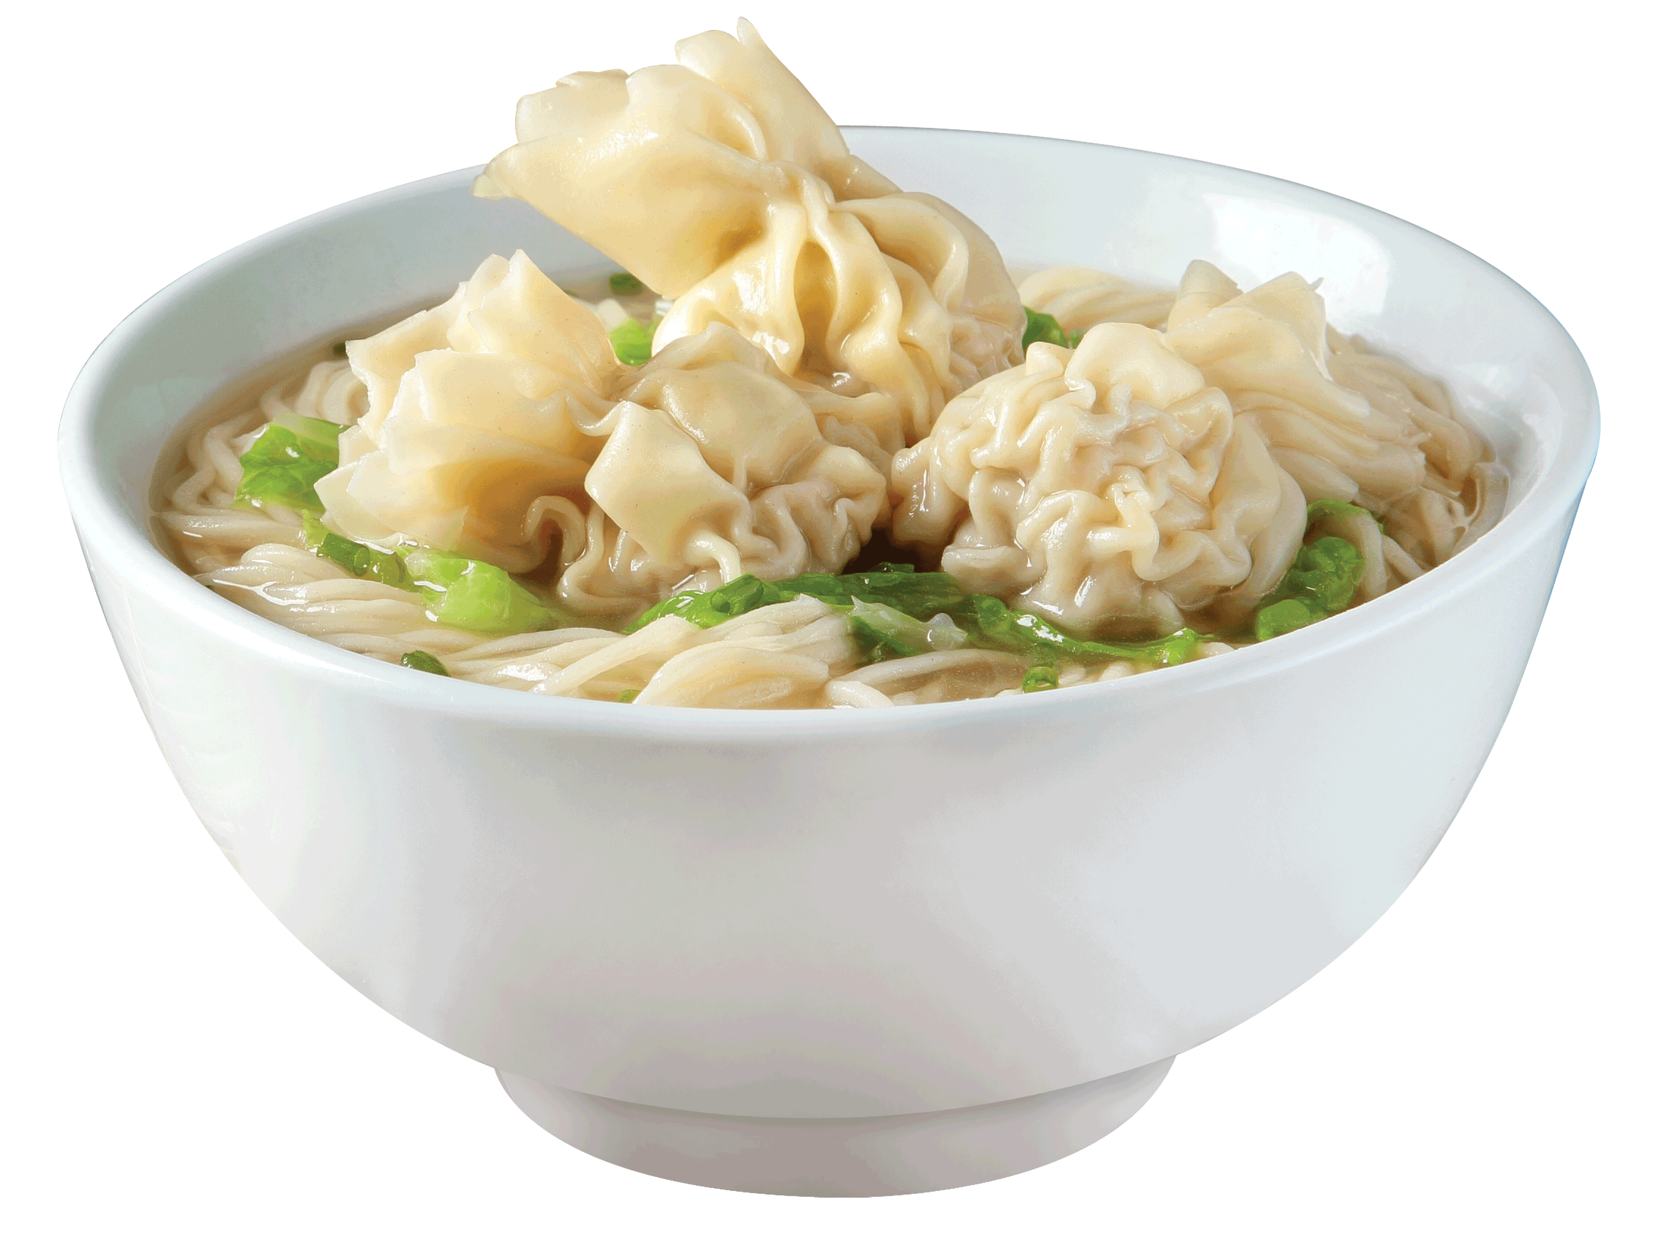
supaya
No, “supaya” is not an exotic Asian soup which contains the eyes of some poor unfortunate animal (although I am certain soups like that actually do exist)!
“supaya” , pronounced “soup-eye-ya” is an Indonesian conjunction or joining-word which means “so that …” .
So that’s enough of that! Let’s take a break “supaya” we can enjoy some delicious soup.

