Slide 2
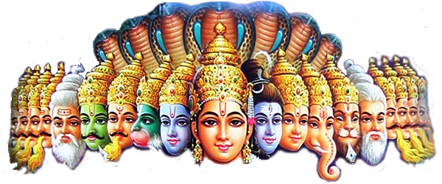
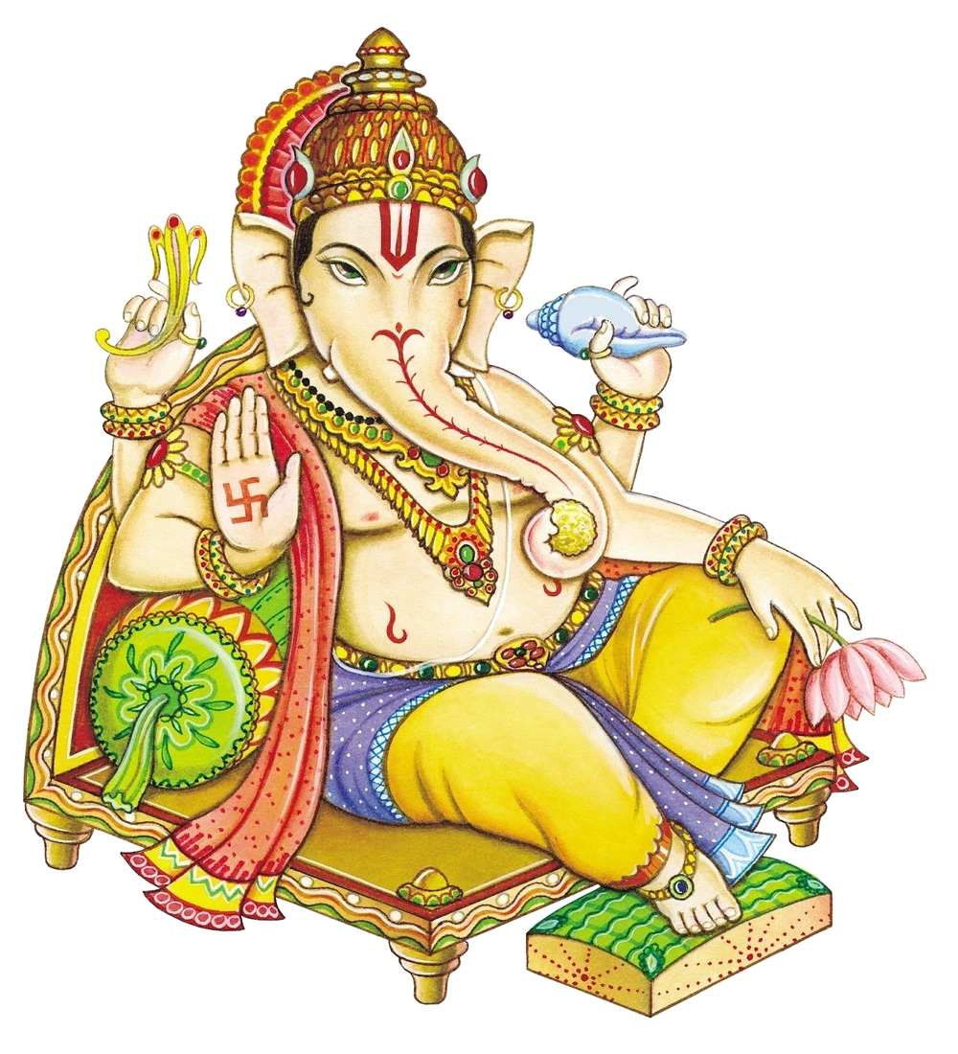
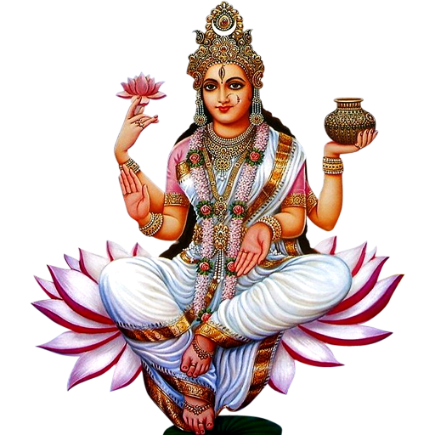
suami

Slide 3
suami
You must think that “suami”, pronounced “sue-ar-mi”, is the Indonesian word for a “Hindu religious teacher” or “swami”, right?
Sorry to disappoint you but the noun “suami” means “husband” in Indonesian.

Slide 4
suami
As you can see from the following images, the typical western “suami”, bears very little resemblance to a Hindu “swami”.

