Slide 2
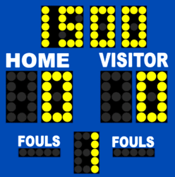
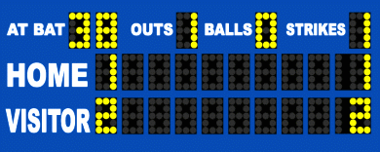
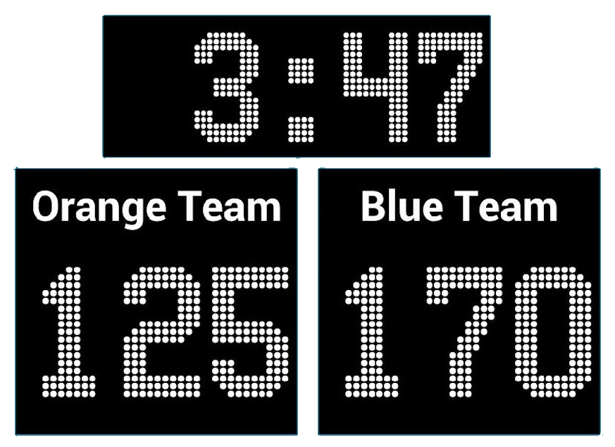
skors

Slide 3
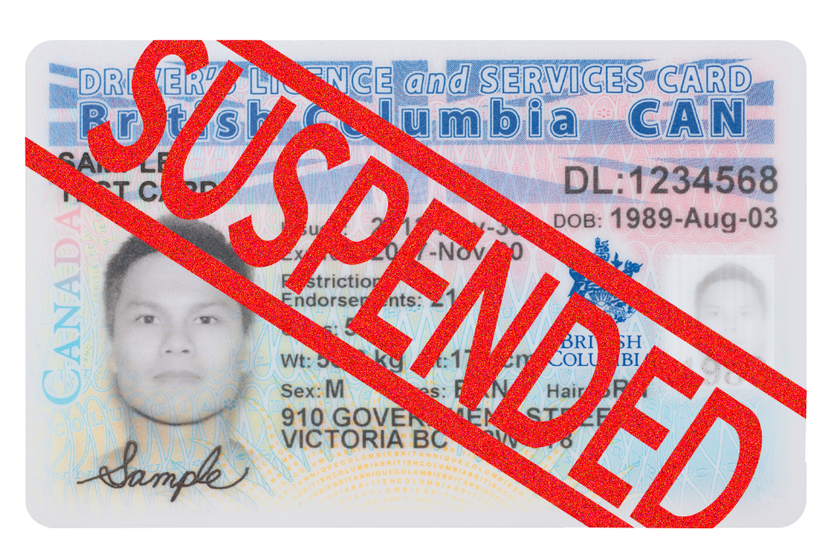
skors
You are probably thinking that “skors”, pronounced “skor-sss”, is the Indonesian word for “score”, right?
If you believe that, you’ve chalked up yet another loss! That makes the “score” 160 – 0 in my favour!
The noun “skors” means a “suspension” in Indonesian.

Slide 4
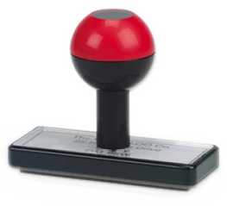
skors
If you are not a respectful and responsible member of the Browns Plains State High School community, we have ways of evening the “skors”!

