Slide 2
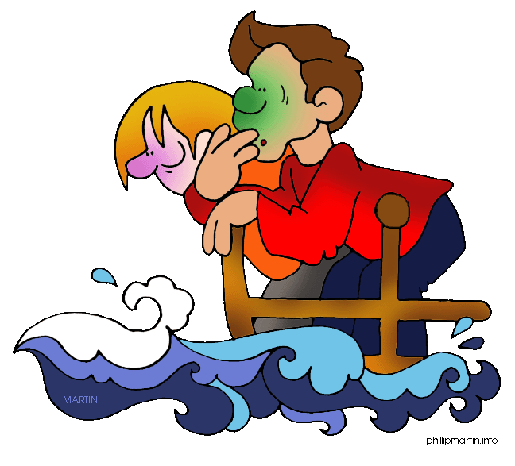
sisik

Slide 3
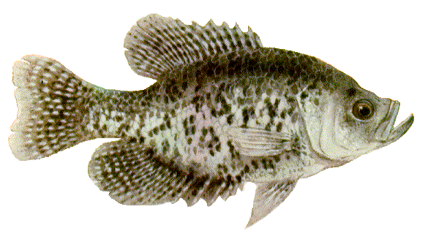
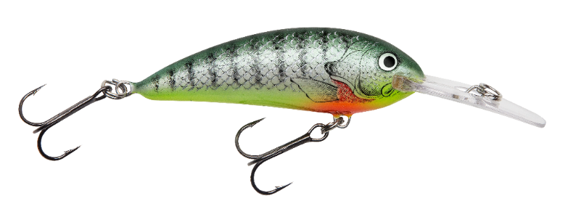
sisik
You are probably thinking that “sisik”, pronounced “sis-ick”, is the Indonesian word for “seasick”, right?
I don’t want to upset your sense of balance, but you are way off the scales if you believe that!
The Indonesian noun “sisik” means “scales” as on the skin of fish.
I don’t find you at all “alluring”!

Slide 4
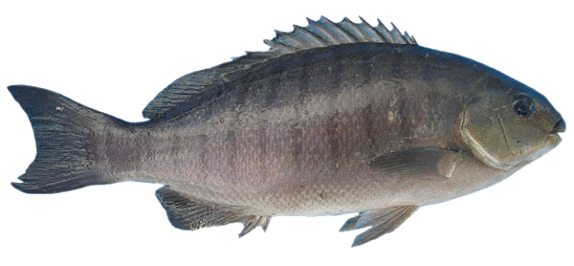
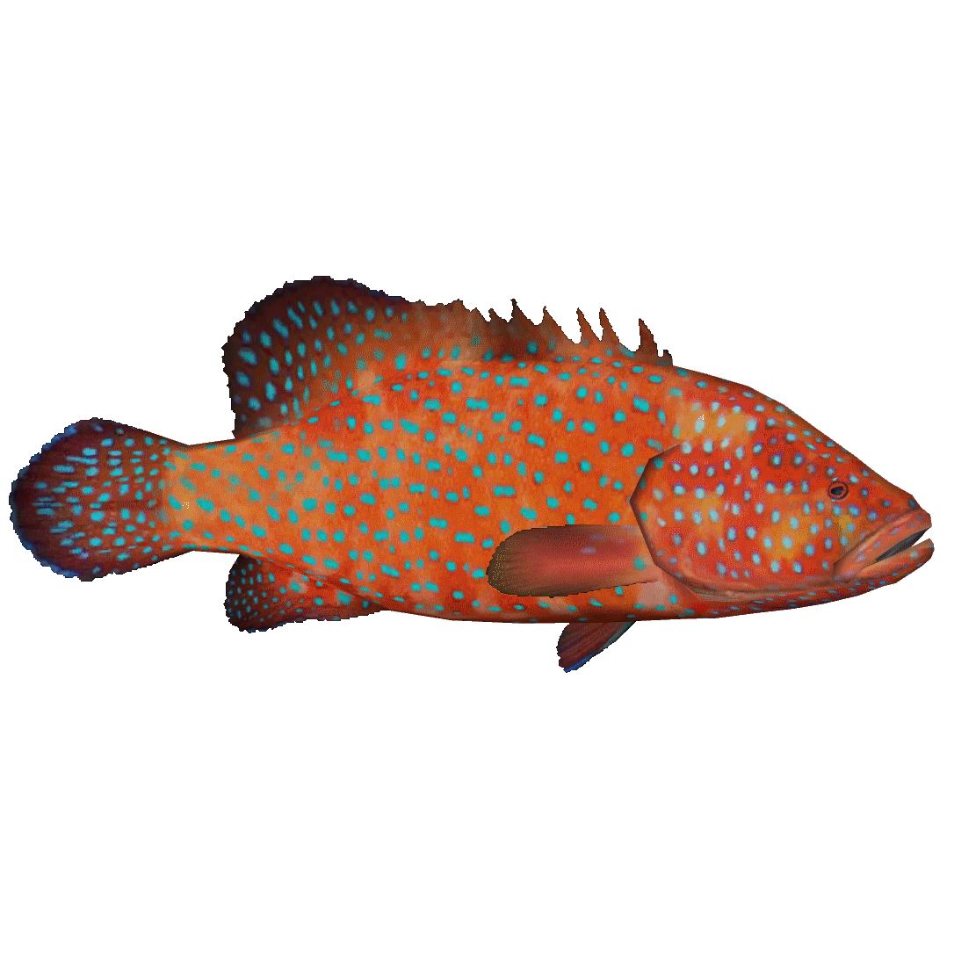
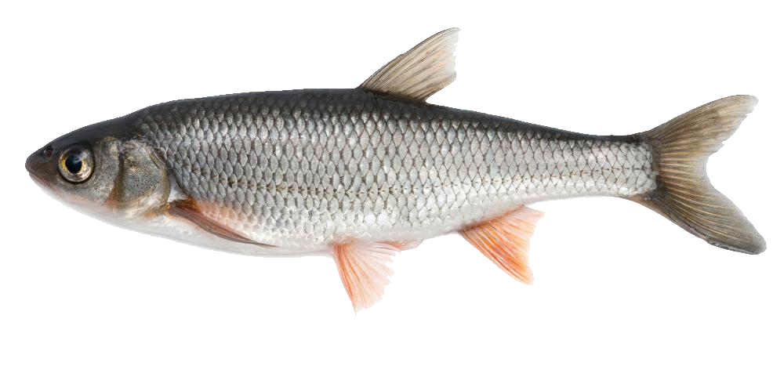
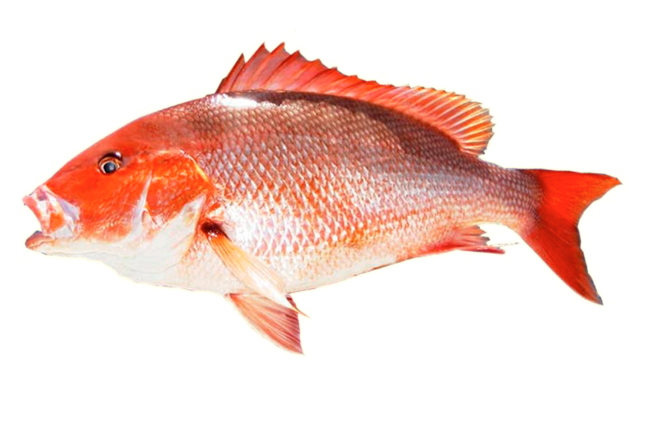
sisik
It seems that there is an epidemic of fish in our oceans suffering from scaly skin! Will we ever find a cure to this most common form of “sisikness” ?

