Slide 2
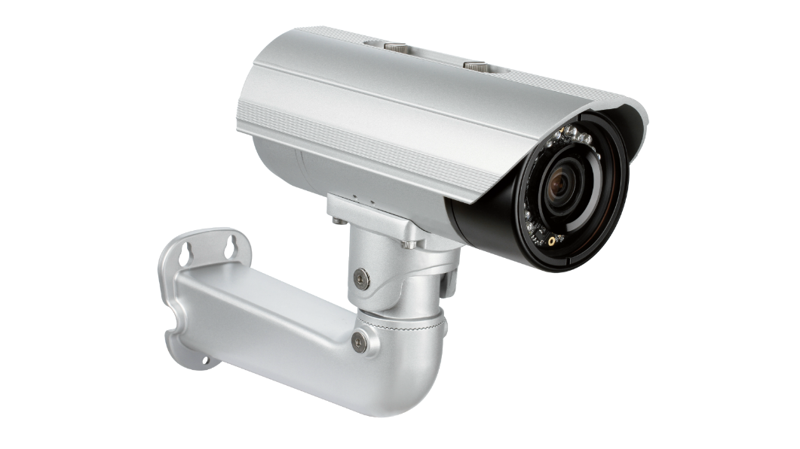
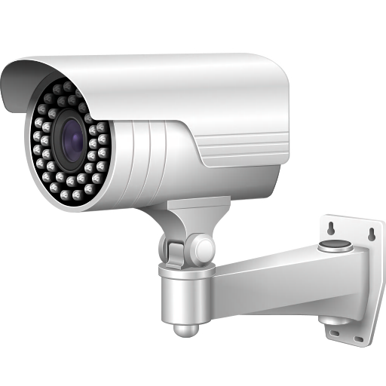
sibuk

Slide 3
sibuk
You are probably thinking that “sibuk”, pronounced “sih-book”, means “looking at a book” in Indonesian, right?
Well, if you believe that, I suggest you get “busy” and look at a dictionary instead. There you will discover that the adjective “sibuk” means “busy” in Indonesian!

Slide 4
sibuk
I don’t know about you, but I’m too “sibuk” writing the Word of the Day to “look at a book”!

