Slide 2
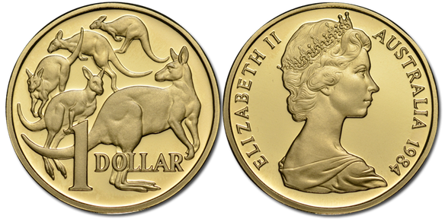
sentuh

Slide 3
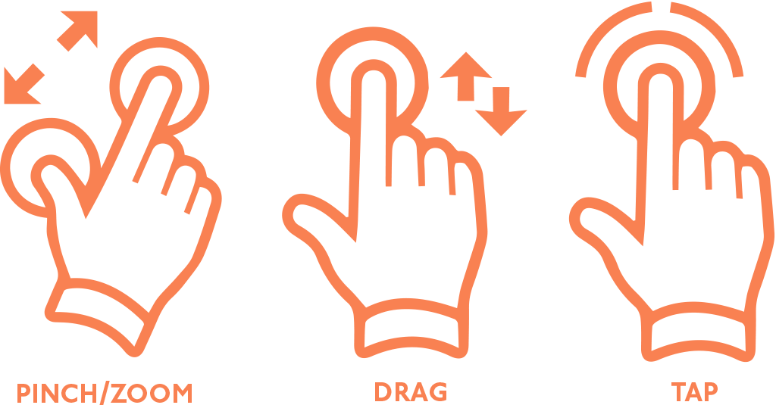
sentuh
I’ll bet you think that “sentuh”, pronounced “sen-two”, means “two cents” in Indonesian, right? Well that would make no “sense” because the Indonesian currency is “rupiah”!
The verb “sentuh” means “to touch” in the Indonesian language.

Slide 4
sentuh
These days, for “two cents” you can look but you can’t “sentuh” !

