Slide 2
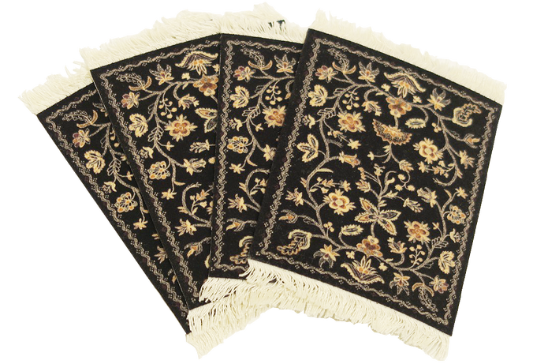
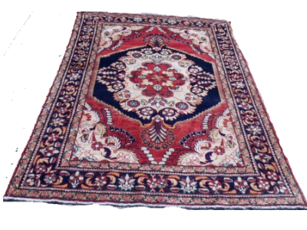
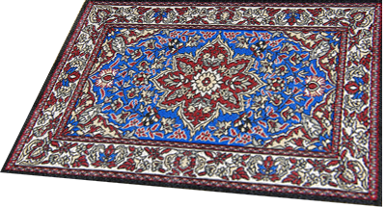
selamat

Slide 3
selamat
You are probably thinking that “selamat”, pronounced “sell-a-mut” means “to sell rugs or mats” in Indonesian, right?
Sorry to “karpet” that idea but “selamat” is the universal Indonesian greeting word that precedes all greetings or congratulatory comments in Indonesian. On its own, “selamat” means “congratulations”.

Slide 4
selamat
Let’s give “selamat” to the Word of the Day.

Slide 5
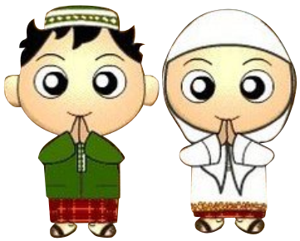
selamat
Each day it takes you on a magical carpet ride as you explore new and interesting Indonesian vocabulary.
Selamat belajar bahasa Indonesia!

