Slide 2
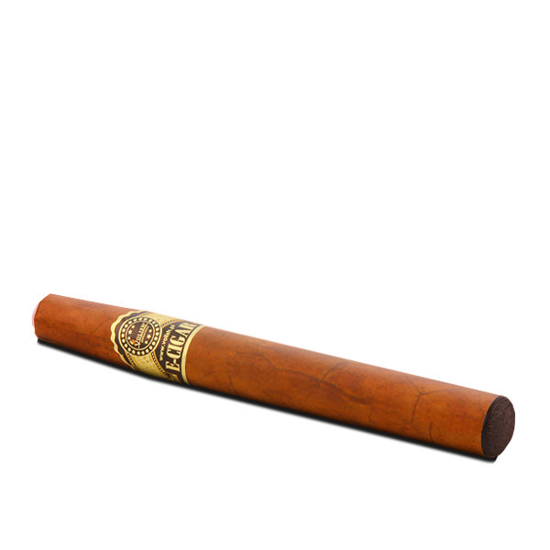
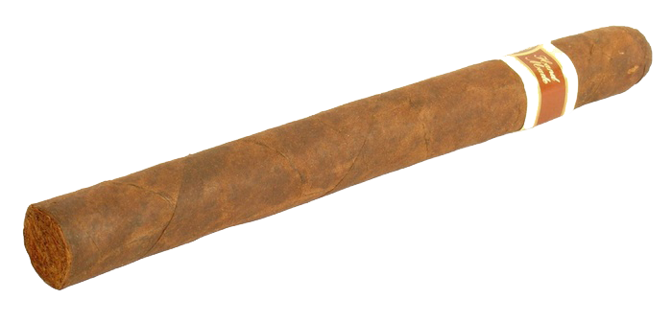
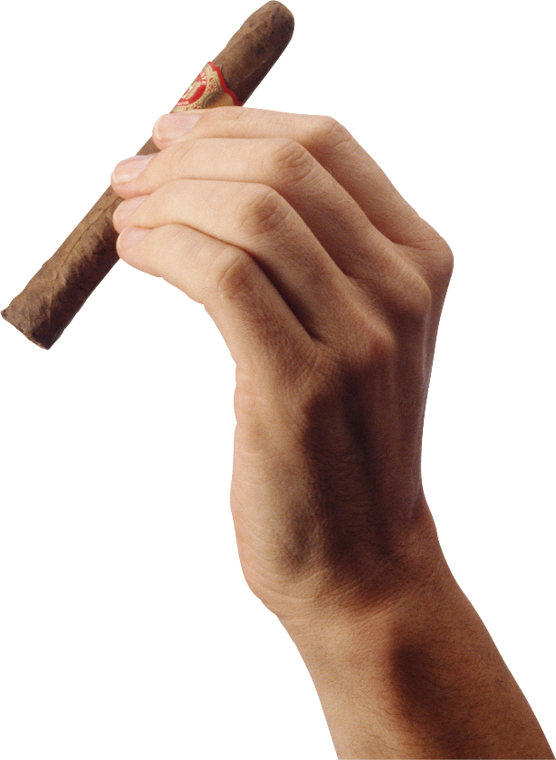
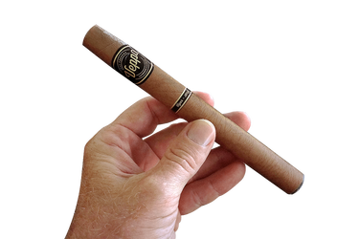
segar

Slide 3
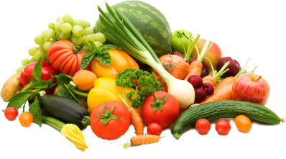
segar
You could be forgiven for thinking that “segar” is the Indonesian word for “cigar”. Nothing could be further from the truth!
The word “segar” means “fresh” and is mostly used to describe fresh produce such as fruit and vegetables.

Slide 4
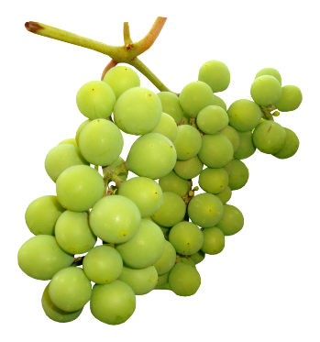
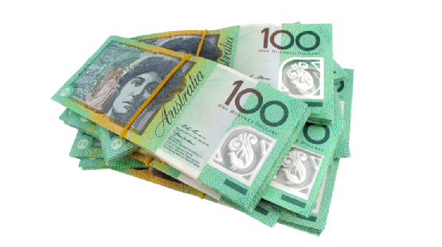
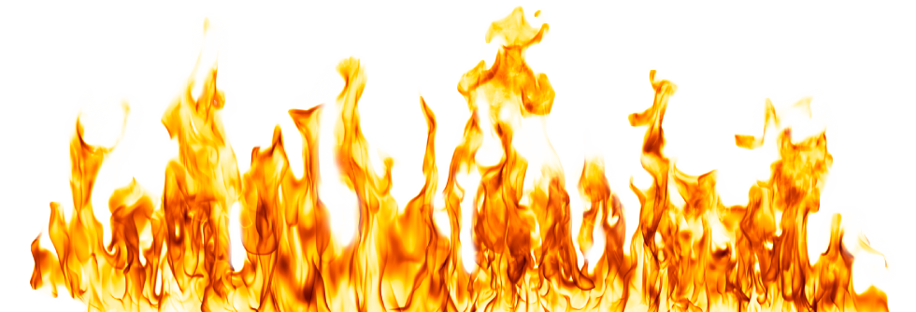
segar
It’s both cheaper and healthier to consume fruit which is “segar” than to enjoy an expensive “cigar” which will see your money disappear in a puff of smoke.

