Slide 1
School Subjects Pronunciation Guide
Say It Like It Is

Slide 2
Bahasa Inggris
Ba-ha-sa Ing-gris
English

Slide 3
Bahasa Indonesia
Ba-ha-sa In-do-ne-si-a
Indonesian

Slide 4
Matematika
Ma-tem-a-ti-ka
Mathematics

Slide 5
Sains
Sa-ins
Science

Slide 6
Geografi
Ge-o-gra-fi
Geography

Slide 7
Sejarah
Se-ja-rah
History

Slide 8
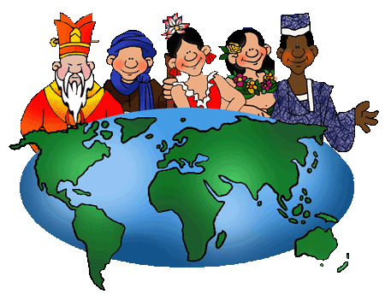
Ilmu Pengetahuan Sosial
Il-mu Peng-e-ta-hu-an So-si-al
Social Sciences

Slide 9
Ilmu Pengetahuan Alam
Il-mu Peng-e-ta-hu-an A-lam
Natural Sciences

Slide 10
Seni Drama
Se-ni Dra-ma
Dramatic Arts

Slide 11
Seni Lukis
Se-ni Lu-kis
Visual Arts

Slide 12
Musik
Mu-sik
Music

Slide 13
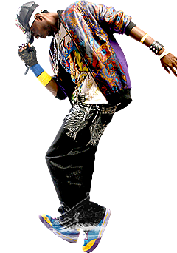
Menari
Mena-ri
Dance

Slide 14
Pendidikan Jasmani
Pen-di-di-kan Jas-ma-ni
Physical Education

Slide 15
Olahraga
O-la-ra-ga
Sport

Slide 16
Membaca
Mem-ba-ca
Literacy

Slide 17
Menhitung
Meng-hi-tung
Numeracy

Slide 18
Agama
A-ga-ma
Religious Studies

Slide 19
Pramuka
Pra-mu-ka
Scouts

