Slide 2
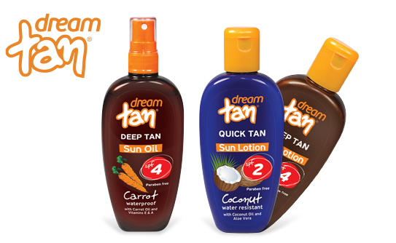
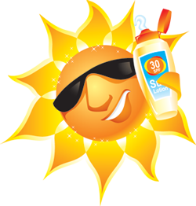
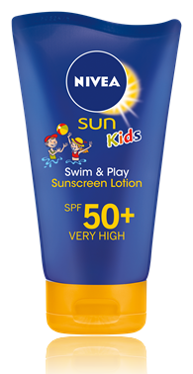
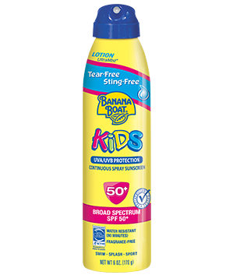
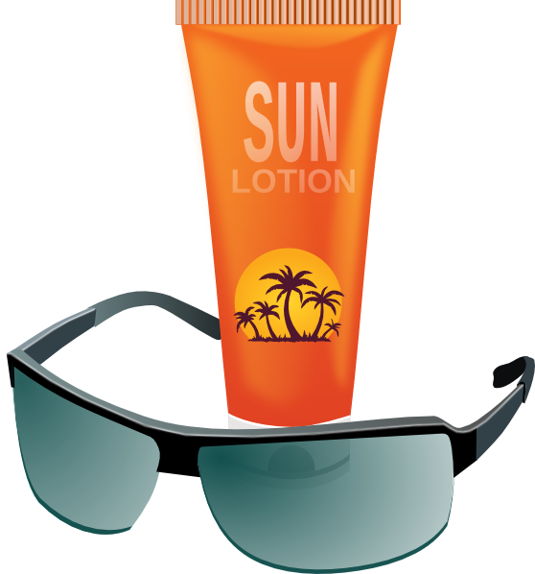
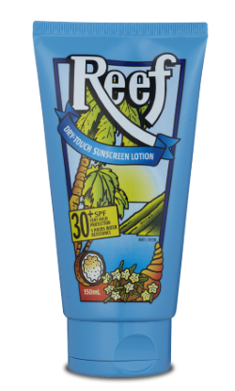
santan

Slide 3
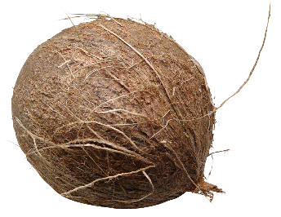
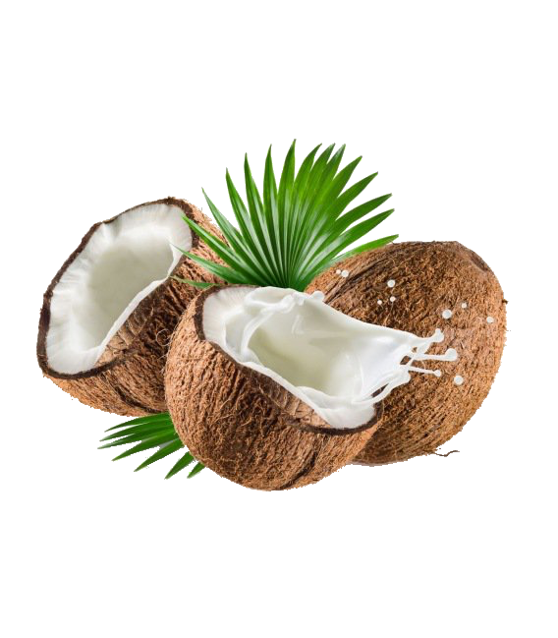
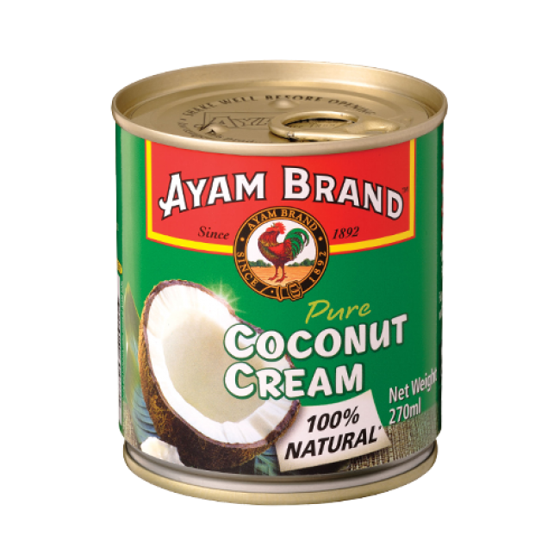
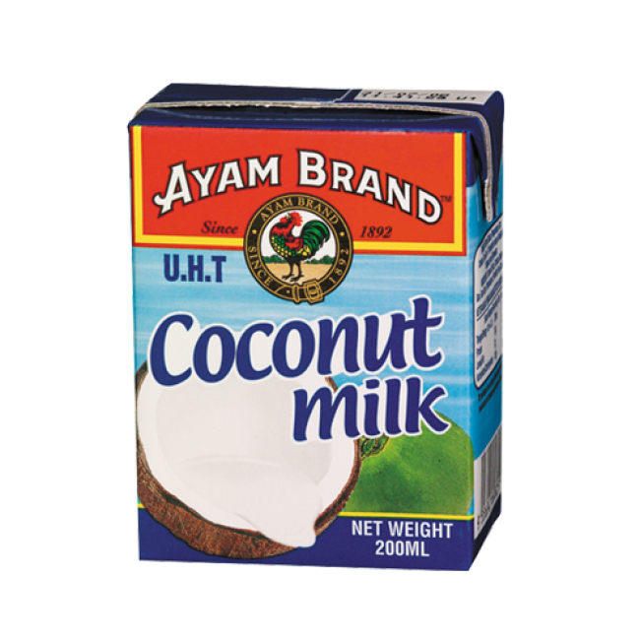
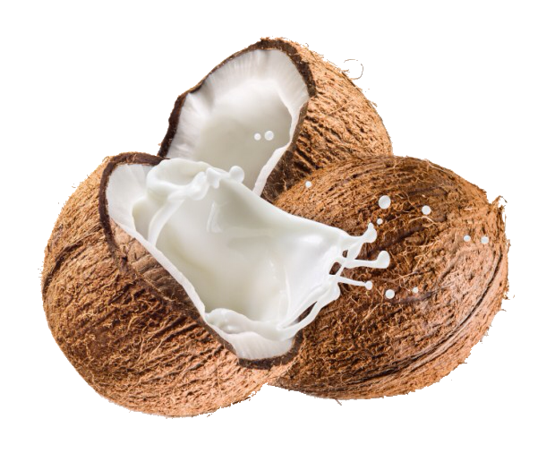
santan
You are probably thinking that “santan”, pronounced “sun-tun”, is the Indonesian word for “sun tan”, right?
I don’t want to take the colour out of your complexion, but the noun “santan” means “coconut milk” in Indonesian.

Slide 4
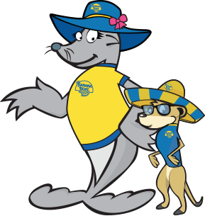
santan
It is no secret that “santan” is an ingredient of many “sun tan” lotions. This does not mean that “santan” makes a “sun tan” safe!
Take extreme care when playing in the sun and don’t forget to “Slip … Slop … Slap … Seek … Slide!”

