Slide 2
sampai

Slide 3
sampai
Would you like to eat some pie? In Indonesian, the word “sampai”, which is pronounced exactly the same as “some pie”, has a totally different meaning!
“sampai” means either “until” or “to arrive at a destination”. For example, “Sampai jumpa lagi” (Until we meet again) or “Saya sudah sampai di Jakarta” (I’ve already arrived in Jakarta).
If you still want some pie, just go to the next slide!

Slide 4
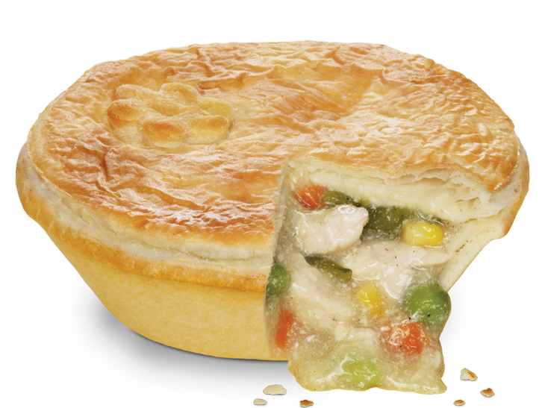
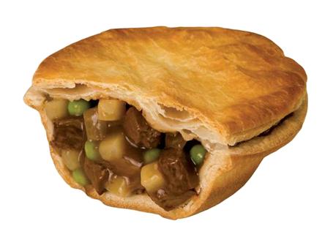
sampai

