Slide 2
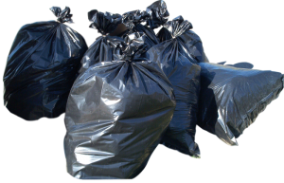
sampah
“Can I have some, Pa ?”

Slide 3
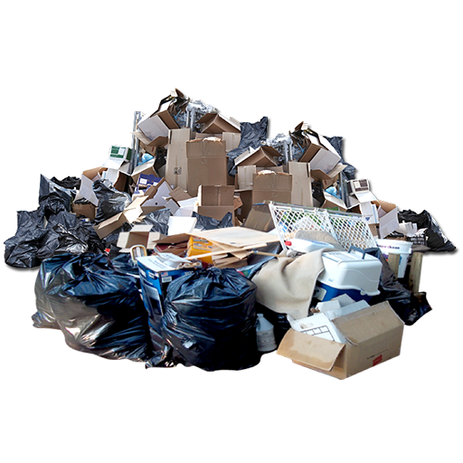
sampah
“Is this enough, Bart?”

Slide 4
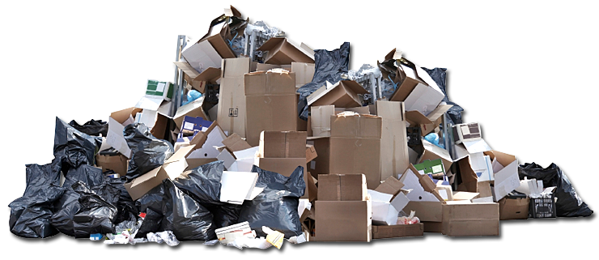
sampah
You have probably already guessed that “sampah”, pronounced “some par” means “trash” or “rubbish” in Indonesian.
In Indonesia’s major cities hundreds of thousands of poor, uneducated scavengers collect other people’s rubbish for recycling.

Slide 5
sampah
They then take the materials they have salvaged at the local “Bank Sampah” or “Trash Bank” where they are paid for their “deposit”.
By this method, in Indonesia, one man’s rubbish is truly another man’s treasure!

Slide 6
sampah

