Slide 2
sama

Slide 3
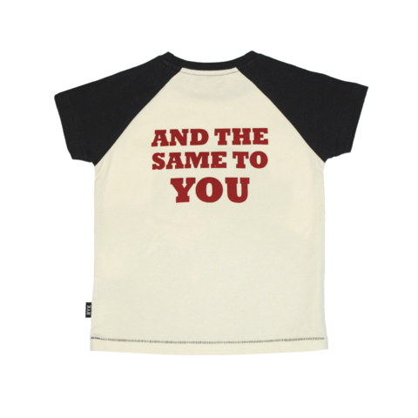
sama
You must surely be thinking that “sama”, pronounced “sum-ah”, is the Indonesian word for “summer”, right?
Sorry to pour cold water on that thought, but the adjective “sama” means “same” and the expression “sama-sama” means, “The same to you” or “You’re welcome” in Indonesian.

Slide 4
sama
With expressions like “sama-sama”, it’s surprising that Indonesian hasn’t adopted other new expressions such as “spring-spring”, “autumn-autumn” & “winter-winter.”
By the way, if you enjoy the Word of the Day, I have just two words for you :

Slide 5
sama
If by any chance you don’t enjoy the Word of the Day, it’s all the “sama” to me! You are entitled to be different!

