Slide 2
rumah

Slide 3
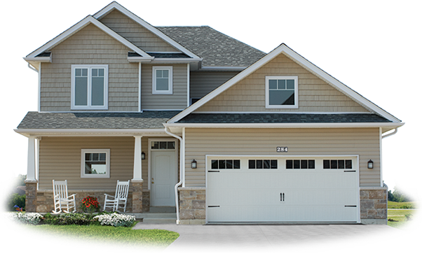
rumah
I know what you’re thinking … “rumah” must be the Indonesian word for “rumor” , right? Unfortunately, you are wrong, as usual!
The word “rumah”, pronounced “ruh-mah”, actually means “house” in Indonesian.

Slide 4
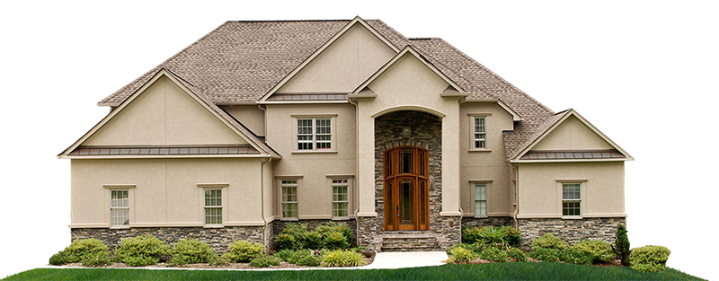
rumah
Don’t you try to spread a “rumah” in Indonesia!

