Slide 2
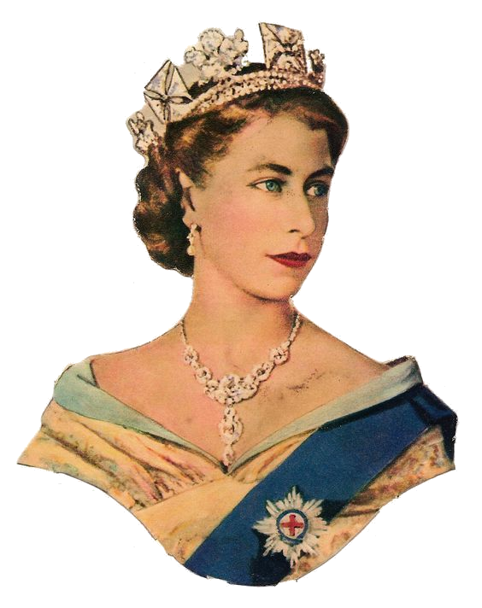
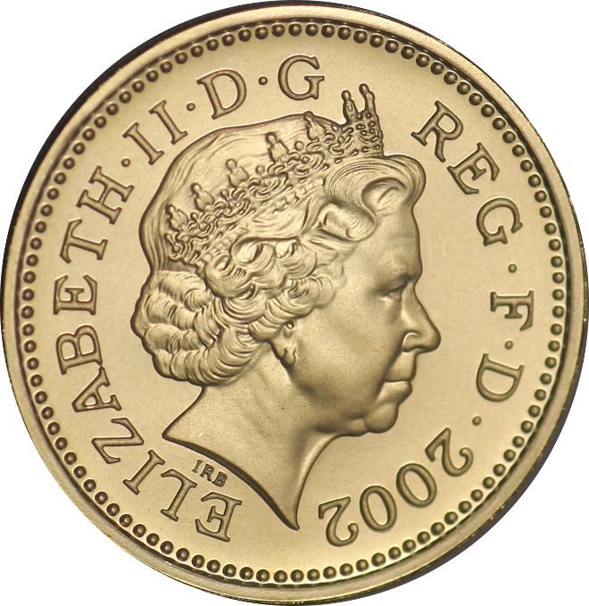
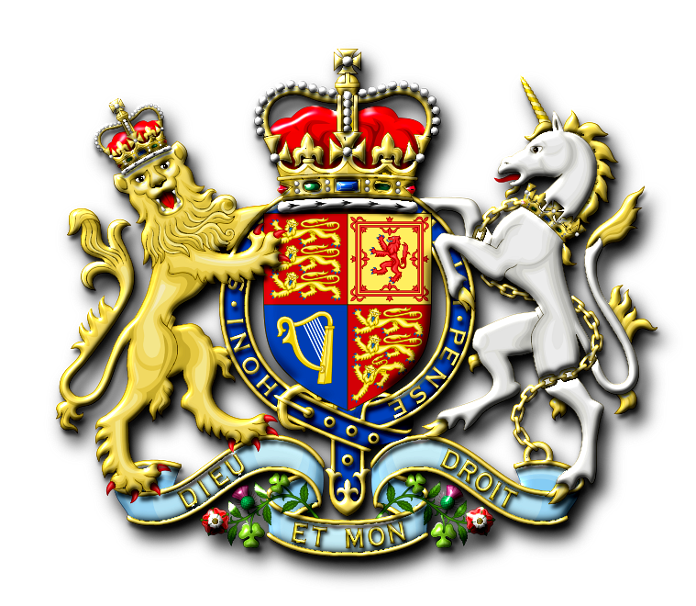
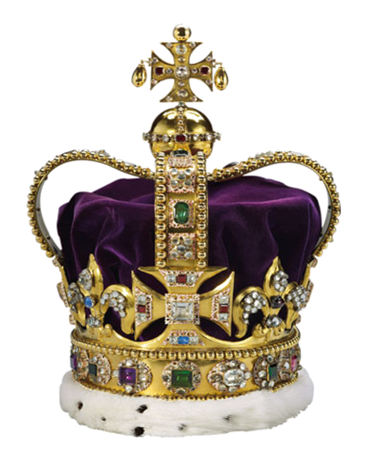
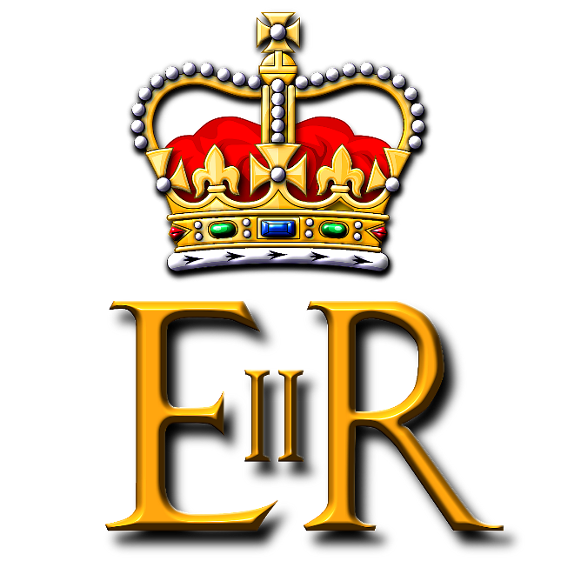
royal

Slide 3
royal
You must surely be thinking that “royal”, pronounced “roy-al”, is the Indonesian word for “royal”, right?
As an Australian “commoner”, you have again displayed your ignorance in “royal” matters!
The adjective “royal” means “generous” in Indonesian.

Slide 4
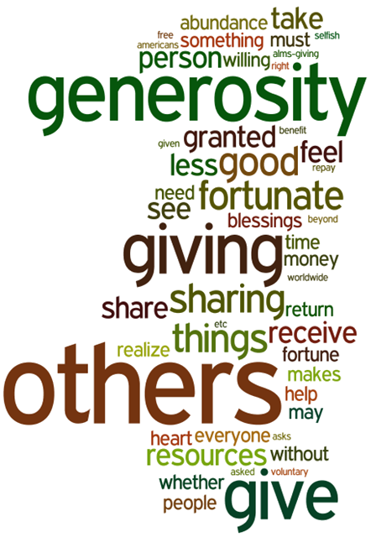
royal
The British “royal” family are renowned for their generosity and charitable work. The adjective “royal” “royal” aptly describes them!

