Slide 2
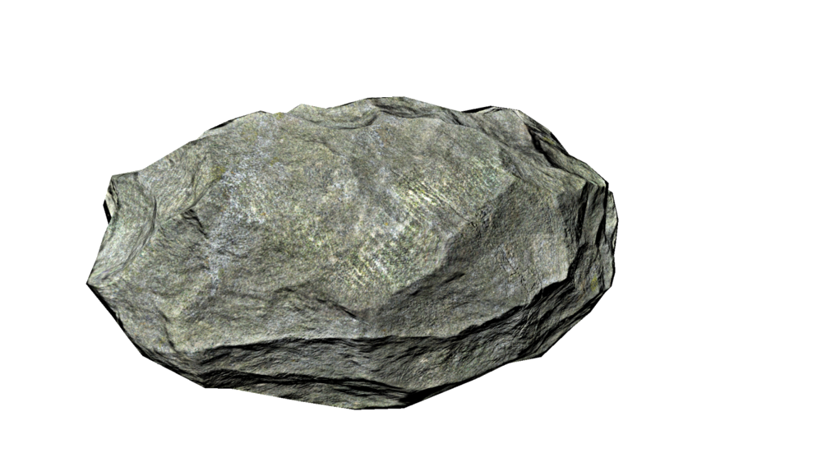
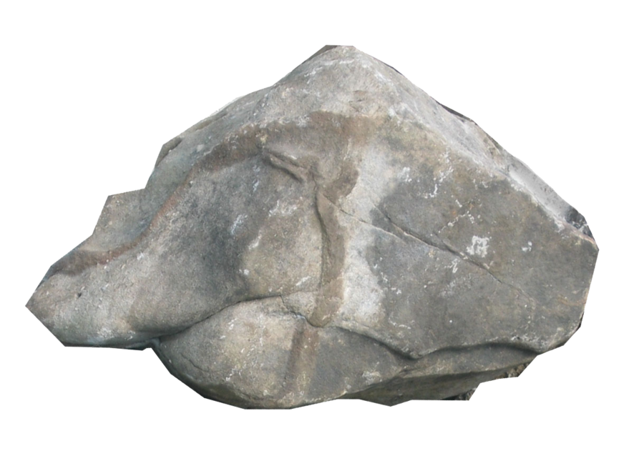
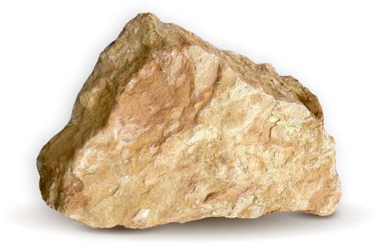
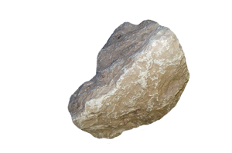
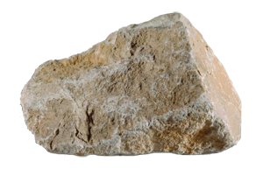
rok

Slide 3
rok
“If you smelllllll what The Rock
is cooking!!!”

Slide 4
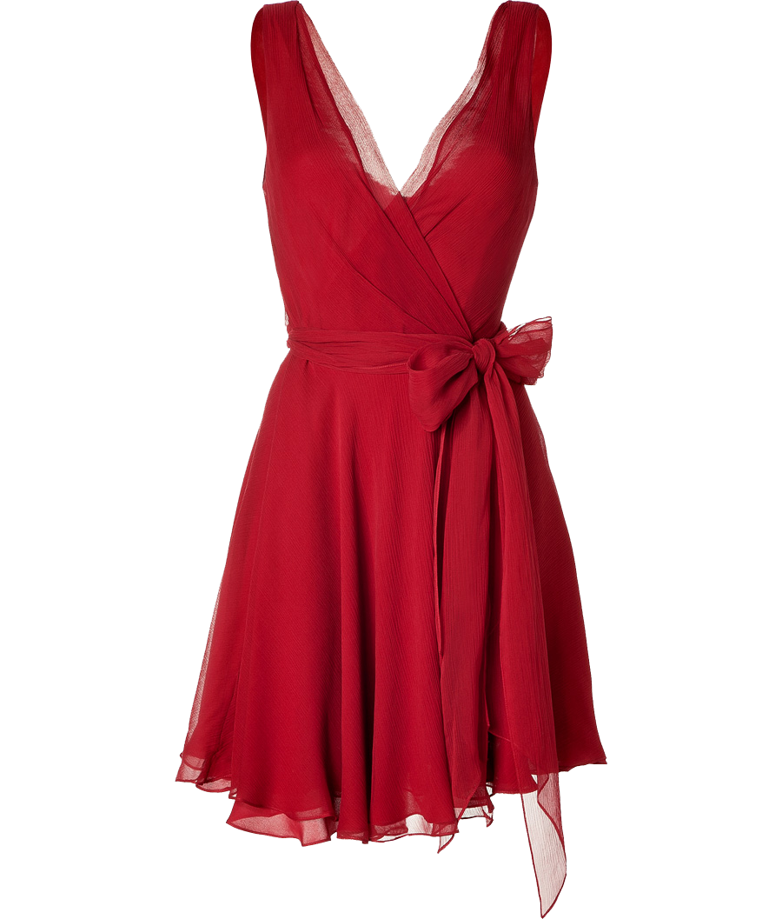
rok
Before you jump to any false conclusions, let me be upfront in telling you that “rok” is neither “a rock” nor the WWE superstar “The Rock” in Indonesian!
The noun “rok” is the generic word for “skirt” or “dress” in Indonesian.

Slide 5
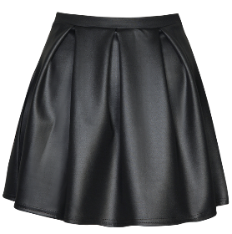
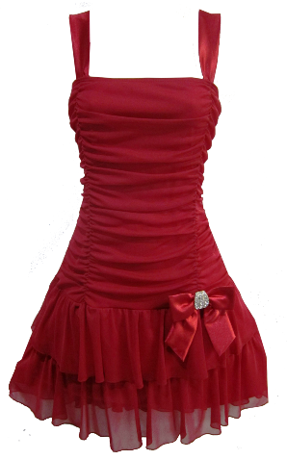
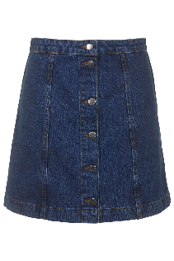
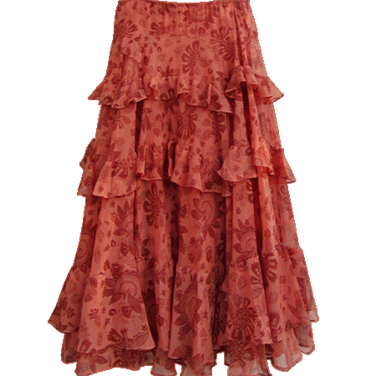
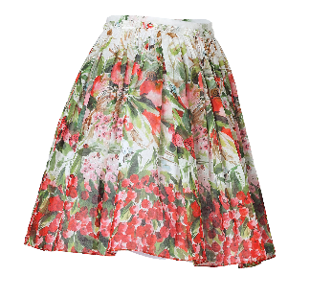
rok
Never tell an Indonesian that they have “rocks in their head” … they would find this very confusing!

