Slide 2
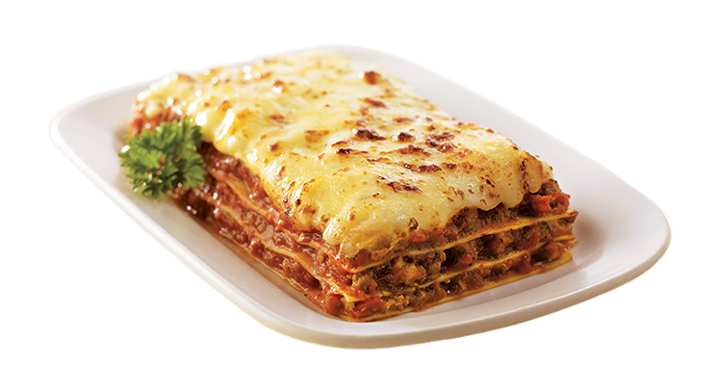
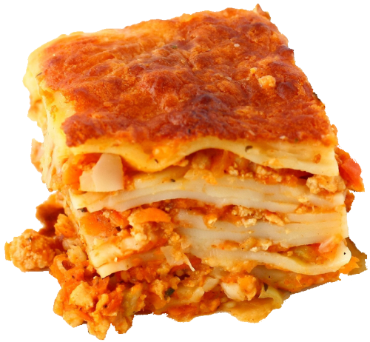
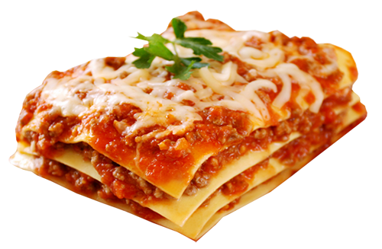
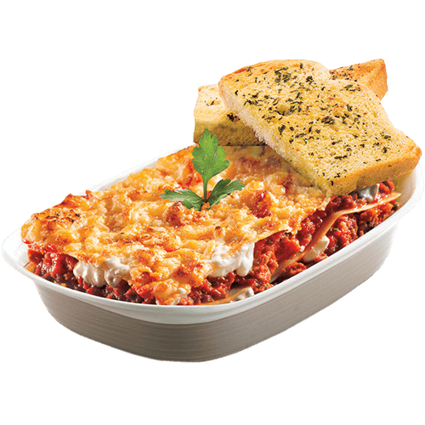
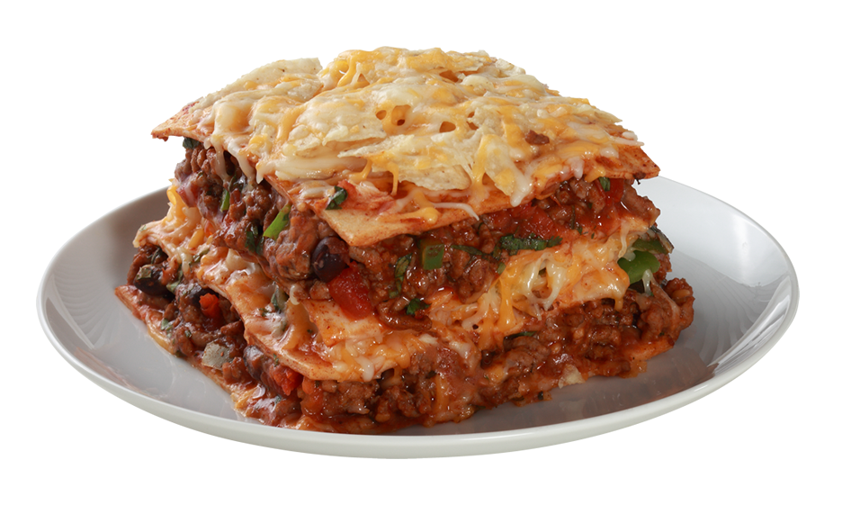
rasanya

Slide 3
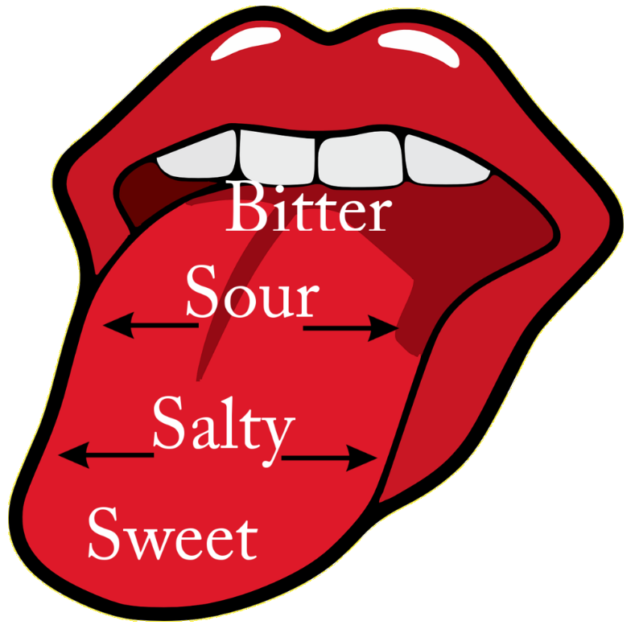
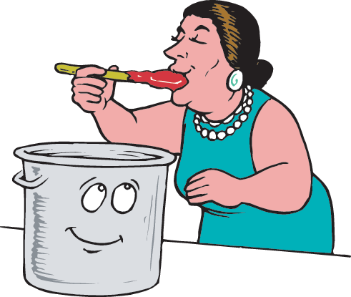
rasanya
I’ll bet you’re thinking that “rasanya”, pronounced “rah-sah-nya”, is the Indonesian word for “lasagne”, right? Sorry to leave a bad taste in your mouth, but you have the wrong “sauce” of information!
The noun “rasanya” means “the taste is …” in Indonesian, and is followed by an adjective describing taste.

Slide 4
rasanya
There are some famous characters who like the “rasanya” of “lasagne”!

