Slide 2
polisi tidur

Slide 3
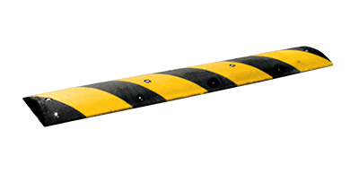
polisi tidur
Translated word-for-word, “polisi tidur” means a
“sleeping police officer”.
However, the real meaning of “polisi tidur” is a “speed bump”!
Have you run into a “polisi tidur” lately?

Slide 4
