Slide 2
pintu

Slide 3
pintu
No, “pintu” does not mean “two pins” , although it is very similar in pronunciation!
“pintu” is the Indonesian word for any kind of “door”.
Life is like a revolving door … if you “pin” all your hopes on one thing, you’ll end up going around in circles!
Worse still, you might find doors slamming in your face!

Slide 4
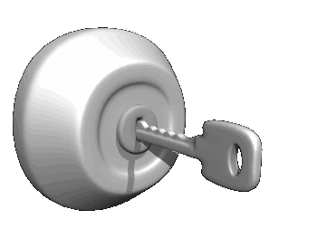
pintu
Success in the study of Indonesian would certainly provide you with a key to unlocking many doors in your future.

