Slide 2
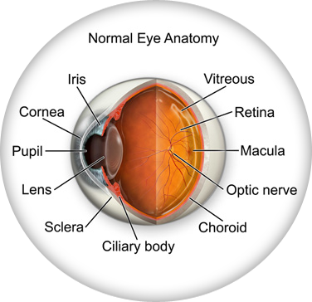
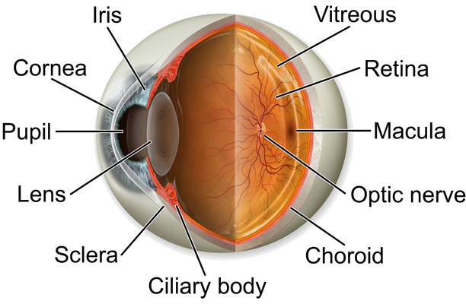
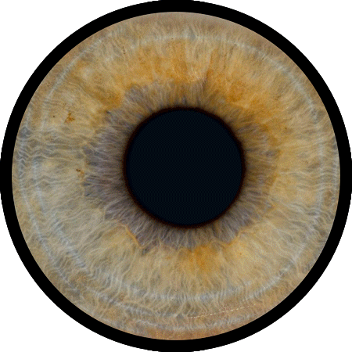
partai

Slide 3
partai
You are probably thinking that “partai”, pronounced “par-tie”, is the Indonesian for “parts of the eye”.
Sorry to inform you that I don’t see “eye-to-eye” with you on this matter.
The noun “partai” means “political party” in Indonesian.

Slide 4
partai
During election time in Indonesia, political rallies can draw more than a million people and often close major roads for hours as each of the political parties take turns to hold their campaign parades. I suppose you could say, “It’s partai time!”

