Slide 2
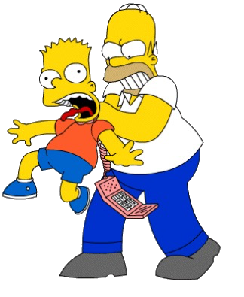
pahit

Slide 3
pahit
You probably think that “pahit”, pronounced “par-hit”, means “to be disciplined by your father” in Indonesian, right?
It may be a “bitter” pill to swallow, but you are wrong again!
The adjective, “pahit” actually means “bitter” in Indonesian.

Slide 4
pahit
I’ll bet good money that you can’t eat a whole lemon or lime. Don’t be “bitter” if you lose the bet!

