Slide 2
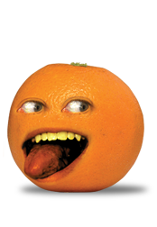
orang

Slide 3
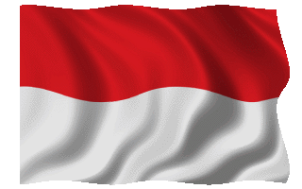
orang
No, the word “orang” has nothing to do with oranges, or any other citrus fruit for that matter!
In Indonesian, “orang” (which is pronounced “or-rung”), means “person” and is the classifier for people.
For example, placed after a number, it indicates a number of people as in “tiga orang” (three people), placed before the name of a country, it indicates nationality as in “orang Indonesia” (an Indonesian) and, finally, when attached to the prefix “se~” and placed before a person’s title or occupation, it produces the indefinite article “a” or “an” as in “seorang dokter” (a doctor).

Slide 4
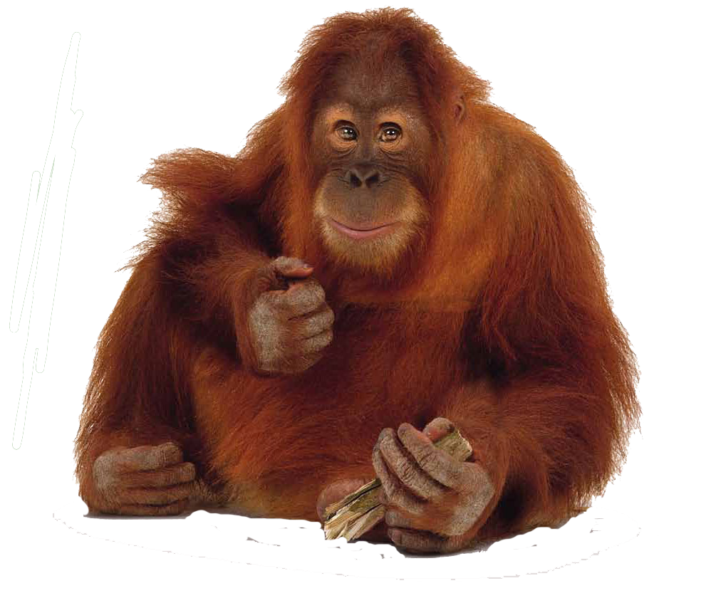
orang
Did you know that the word “orang-utan” comes from the Indonesian words “orang hutan” which means “forest man” ?

Slide 5
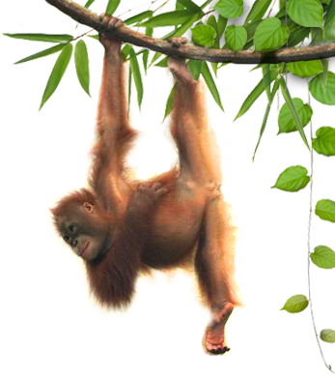
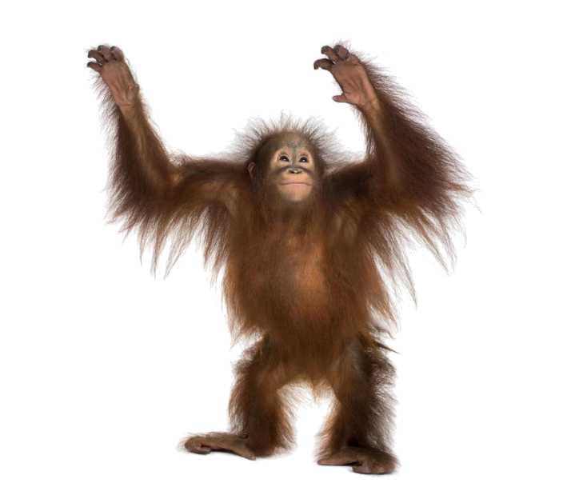
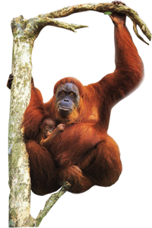
orang
Another interesting fact is that we humans share 97% of an orangutan’s DNA. Now that would certainly explain the behaviour of certain people!

