Slide 2
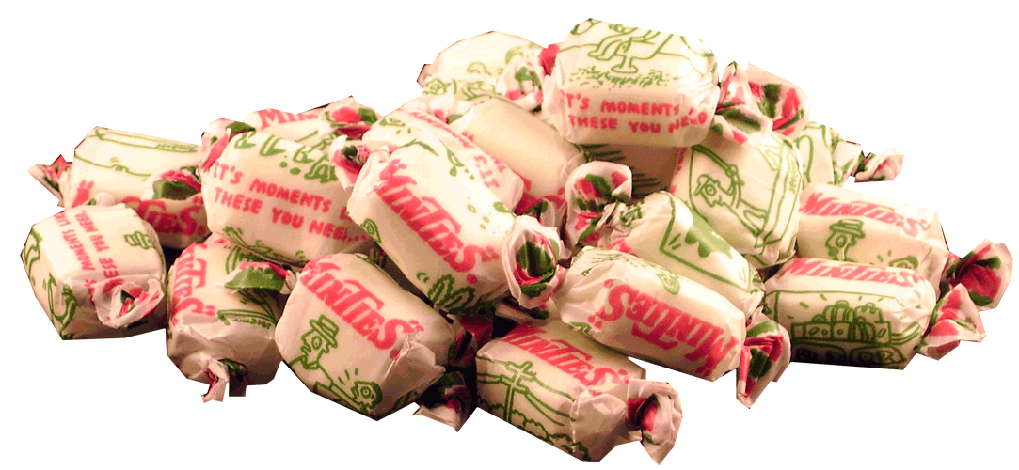
minta

Slide 3
minta
No, this is not a cheap Indonesian imitation of Minties!
The verb “Minta …” means “May I please have a …” and is possibly the single most important term when shopping in Indonesia.
What would you like to “minta” ???

