Slide 2
Mi
Do you like Mi ?

Slide 3
Mi
Do you want Mi ?

Slide 4
Mi
Do you want to eat a portion of Mi ?

Slide 5
Mi
Allow me to show you some pictures of Mi ?

Slide 6
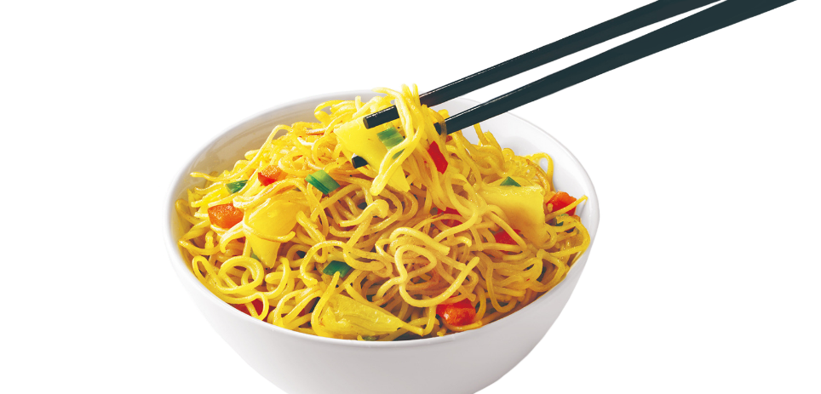
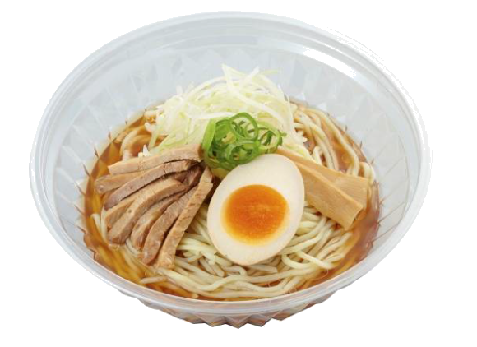
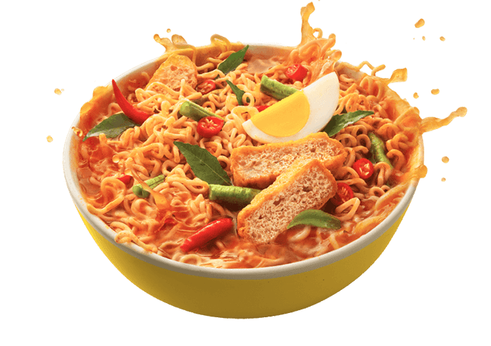
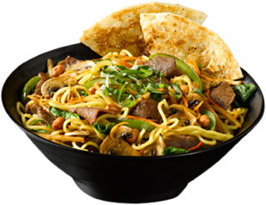
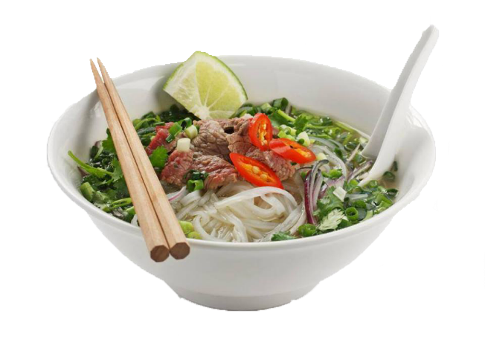
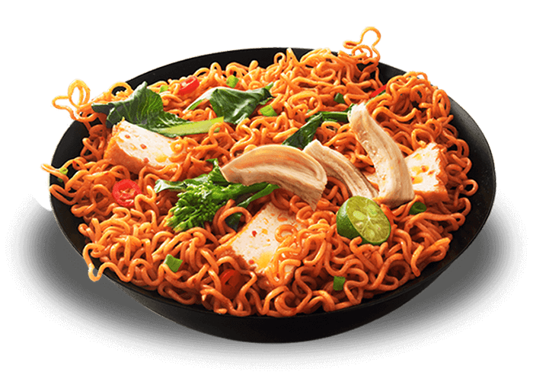
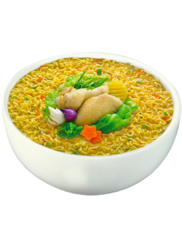
Mi
Here they are !
I hope you like Mi !

Slide 7
Mi
You should have guessed by now that “mi” is the Indonesian word for “noodles” !
Another interesting fact is that “Indomie” noodles from Indonesia are the most popular instant noodles in the entire world (including China), making “Indomie” the largest producer of instant noodles in the world !
By now, you’ve probably had enough of Me.

